Slide 1
The Early Bird’s Guide to Building Your “Budget Ask”
Michigan’s Children’s Lunch and Learn
October 25, 2023

Slide 2
Welcome & Housekeeping
Thank you for being here. Please take a moment to say hello in the chat … your name, organization.
If you have any questions, please post them in the chatbox. Staff will monitor them. You are all muted.
We are recording today’s session on Zoom, and
simultaneously on Facebook Live. The recording will be
available at the of the day at www.michiganschildren.org
under Programs & Events.

Slide 3
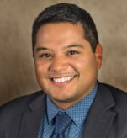
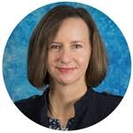
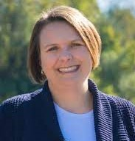
Our Guests and Panelists
Erin Skene-Pratt,
Exec. Director, MASP
Christy Callahan, President,
Early On Michigan Foundation
Patrick Brown
Exec. Director, MACAE

Slide 4
The Background
The FY 2024 state budget took effect Oct. 1, 2023, and runs through Sept. 30. 2024.
This fall, state agencies are submitting their FY 2025 budget requests to the State Budget Office, which coordinates all aspects of the state budget, including development of the Executive Budget recommendations.
Around January, the Governor is expected to submit her executive budget plan to the Legislature.
From there, the Senate and House Committees on Appropriations will review it, Eventually, both chambers will develop their own budget plans and appropriations bills.
The differences between the two sides will be resolved in a later conference committee.
Final legislative action is expected by the time lawmakers break for summer recess.

Slide 5
Panel Discussion Questions
Q1. What were your current budget year outcomes (in FY 2024) and how are those outcomes like to influence what you ask for in the next year’s budget?
Matt Gillard, President & CEO,
Michigan’s Children
Q. new
Q. new
Q. What can we do? Suggestions for advocacy?

Slide 6
Panel Questions
Q2. How does your organization decide what to ask for?
What’s your internal process that would be useful for other organizations to hear?
Q. new
Q. new
Q. What can we do? Suggestions for advocacy?

Slide 7
Panel Questions
Q3. What meaningful information do you assemble to make your pitch?
What are you bringing into the conversation with the Executive Branch?
Examples: Particular demographics, data points, proposals from other states?
Q. new
Q. new
Q. What can we do? Suggestions for advocacy?

Slide 8
Panel Questions
Q4. What signals are you looking for that indicate whether your request has a good chance for success?
Q. new
Q. new
Q. What can we do? Suggestions for advocacy?

Slide 9
In Closing:
Find a recording of today’s meeting under Program & Events, www.michiganschildren.org
Join us for our next Lunch & Learn in November. Look for our Podcast next week.
Sign up to receive our bulletin at www.Michiganschildren.org

