Slide 1
Understanding the Federal Budget Process: What Child Advocates Should Know this Year
Michigan Children’s Lunch and Learn
Aug. 16, 2023

Slide 2
Our Agenda
Welcome: Teri Banas, Director for Programs and Communications, Michigan’s Children
Guests: Danielle Ewen, Policy and Advocacy Consultant, Sixth Street Associates
Noel Benson, Fiscal Analyst, House Fiscal Agency
Kali Fox, Regional Manager, U.S. Sen. Debbie Stabenow
Alicia Wilson-Ahlstrom, Co-director of Research Capacity, Children’s Funding Project
Presentations:
Danielle Ewen: “A Federal Update on Current ECE Funding & What’s at Stake”
Noel Benson: “Federal Funding for Key Programs in Michigan’s Budget”
Panelists Roundtable Discussion: Matt Gillard, President & CEO, Michigan’s Children

Slide 3
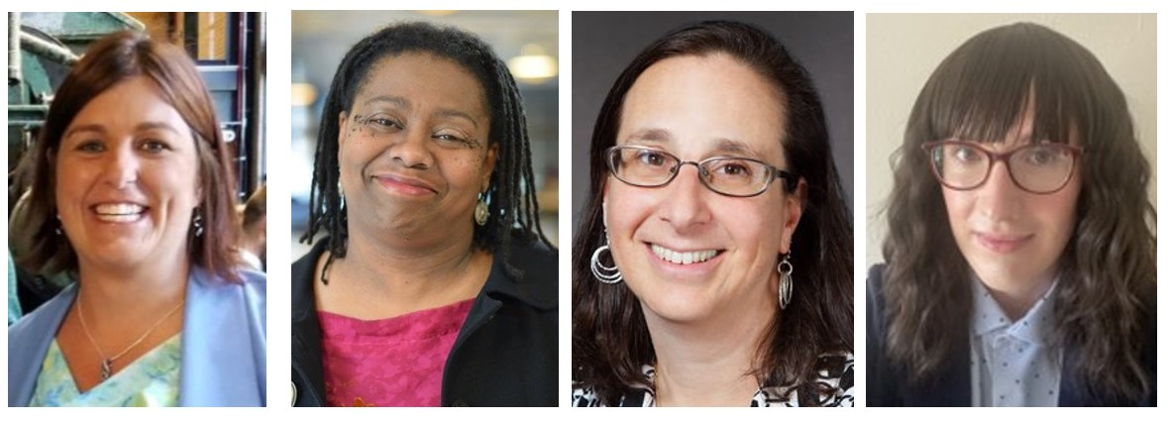
Our Wonderful Guest Speakers & Panelists
Kali Fox, regional manager, U.S. Senator Debbie Stabenow
Alicia Wilson-Ahlstrom, Co-director of Research Capacity, Children’s Funding Project
Danielle Ewen, Policy and Advocacy Consultant, Sixth Street Associates
Noel Benson, Fiscal Analyst, House Fiscal Agency

Slide 4
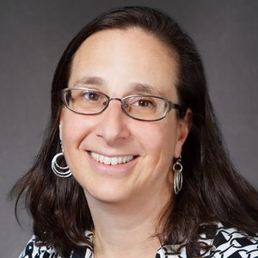
A Federal Update on Current ECE Funding
Danielle Ewen, Policy and Advocacy Consultant, Sixth Street Associates

Slide 5
Current ECE Funding
Program | FY 22 Funding Levels | FY 23 Funding Levels | Increase (FY 22 –FY 23)
CCDBG/CCDF (discretionary) | $6.2 billion | $8.02 billion | $1.9 billion
CCDBG/CCDF (entitlement) | $3.6 billion | $3.6 billion | -
Head Start/Early Head Start | $11.04 billon | $12 billion | $960 million
Preschool Development Grants | $290 million | $315 million | $25 million
IDEA Preschool and Part C Grants for Infants and Toddlers | $409.5 million $496.3 million | $430 million $540 million | $10 million $44 million
Does not include covid relief funds | Does not include covid relief funds
PAPAGGEE
1212

Slide 6
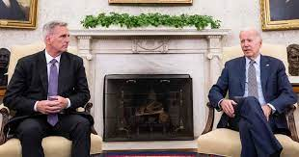
The Debt Agreement Drives Appropriations
Agreement establishes caps and rules in case of deadlock
but does not prevent government shutdown
Nondefense discretionary programs (includes ECE) flat funded
Total spending is capped for at least 2 years
If all appropriations bills not finished by Dec 31, across the board cut of 1 percent
Unspent Covid relief funds returned to the Treasury ($29 billion)
Shuts off pandemic pause of student loans

Slide 7
The FY24 Appropriations Process
Short timeline, different goals, compromise needed.
House of Representatives
“Agreement is a ceiling, not a floor…”
Revert to FY 22 levels
CCDBG held harmless
Cuts Head Start by $750 million
Cuts Title I and teacher prep
Eliminates PDG, CCAMPIS
Eliminates Women’s Bureau
Senate
Bipartisan agreement to move all appropriations bills
Hold most programs harmless to meet debt ceiling agreements
Push for increased spending on social programs, border security

Slide 8
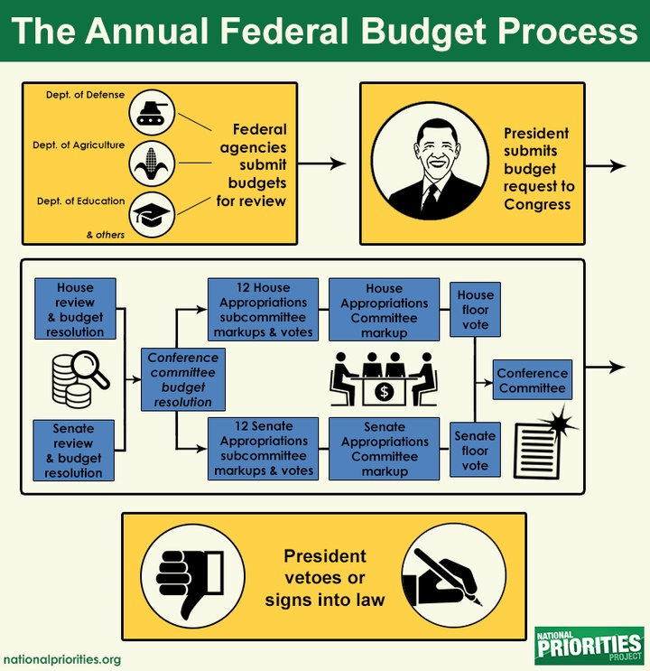
The (Normal) Federal Budget Process

Slide 9
What This Means for ECE Advocacy
Our voices must be heard! Take advantage of the long recess to meet your members.
Tell our stories to everyone!
Our crisis is not new.
Messaging is about protection, not growth.
There is a short window to make the case to protect ECE investments.

Slide 10
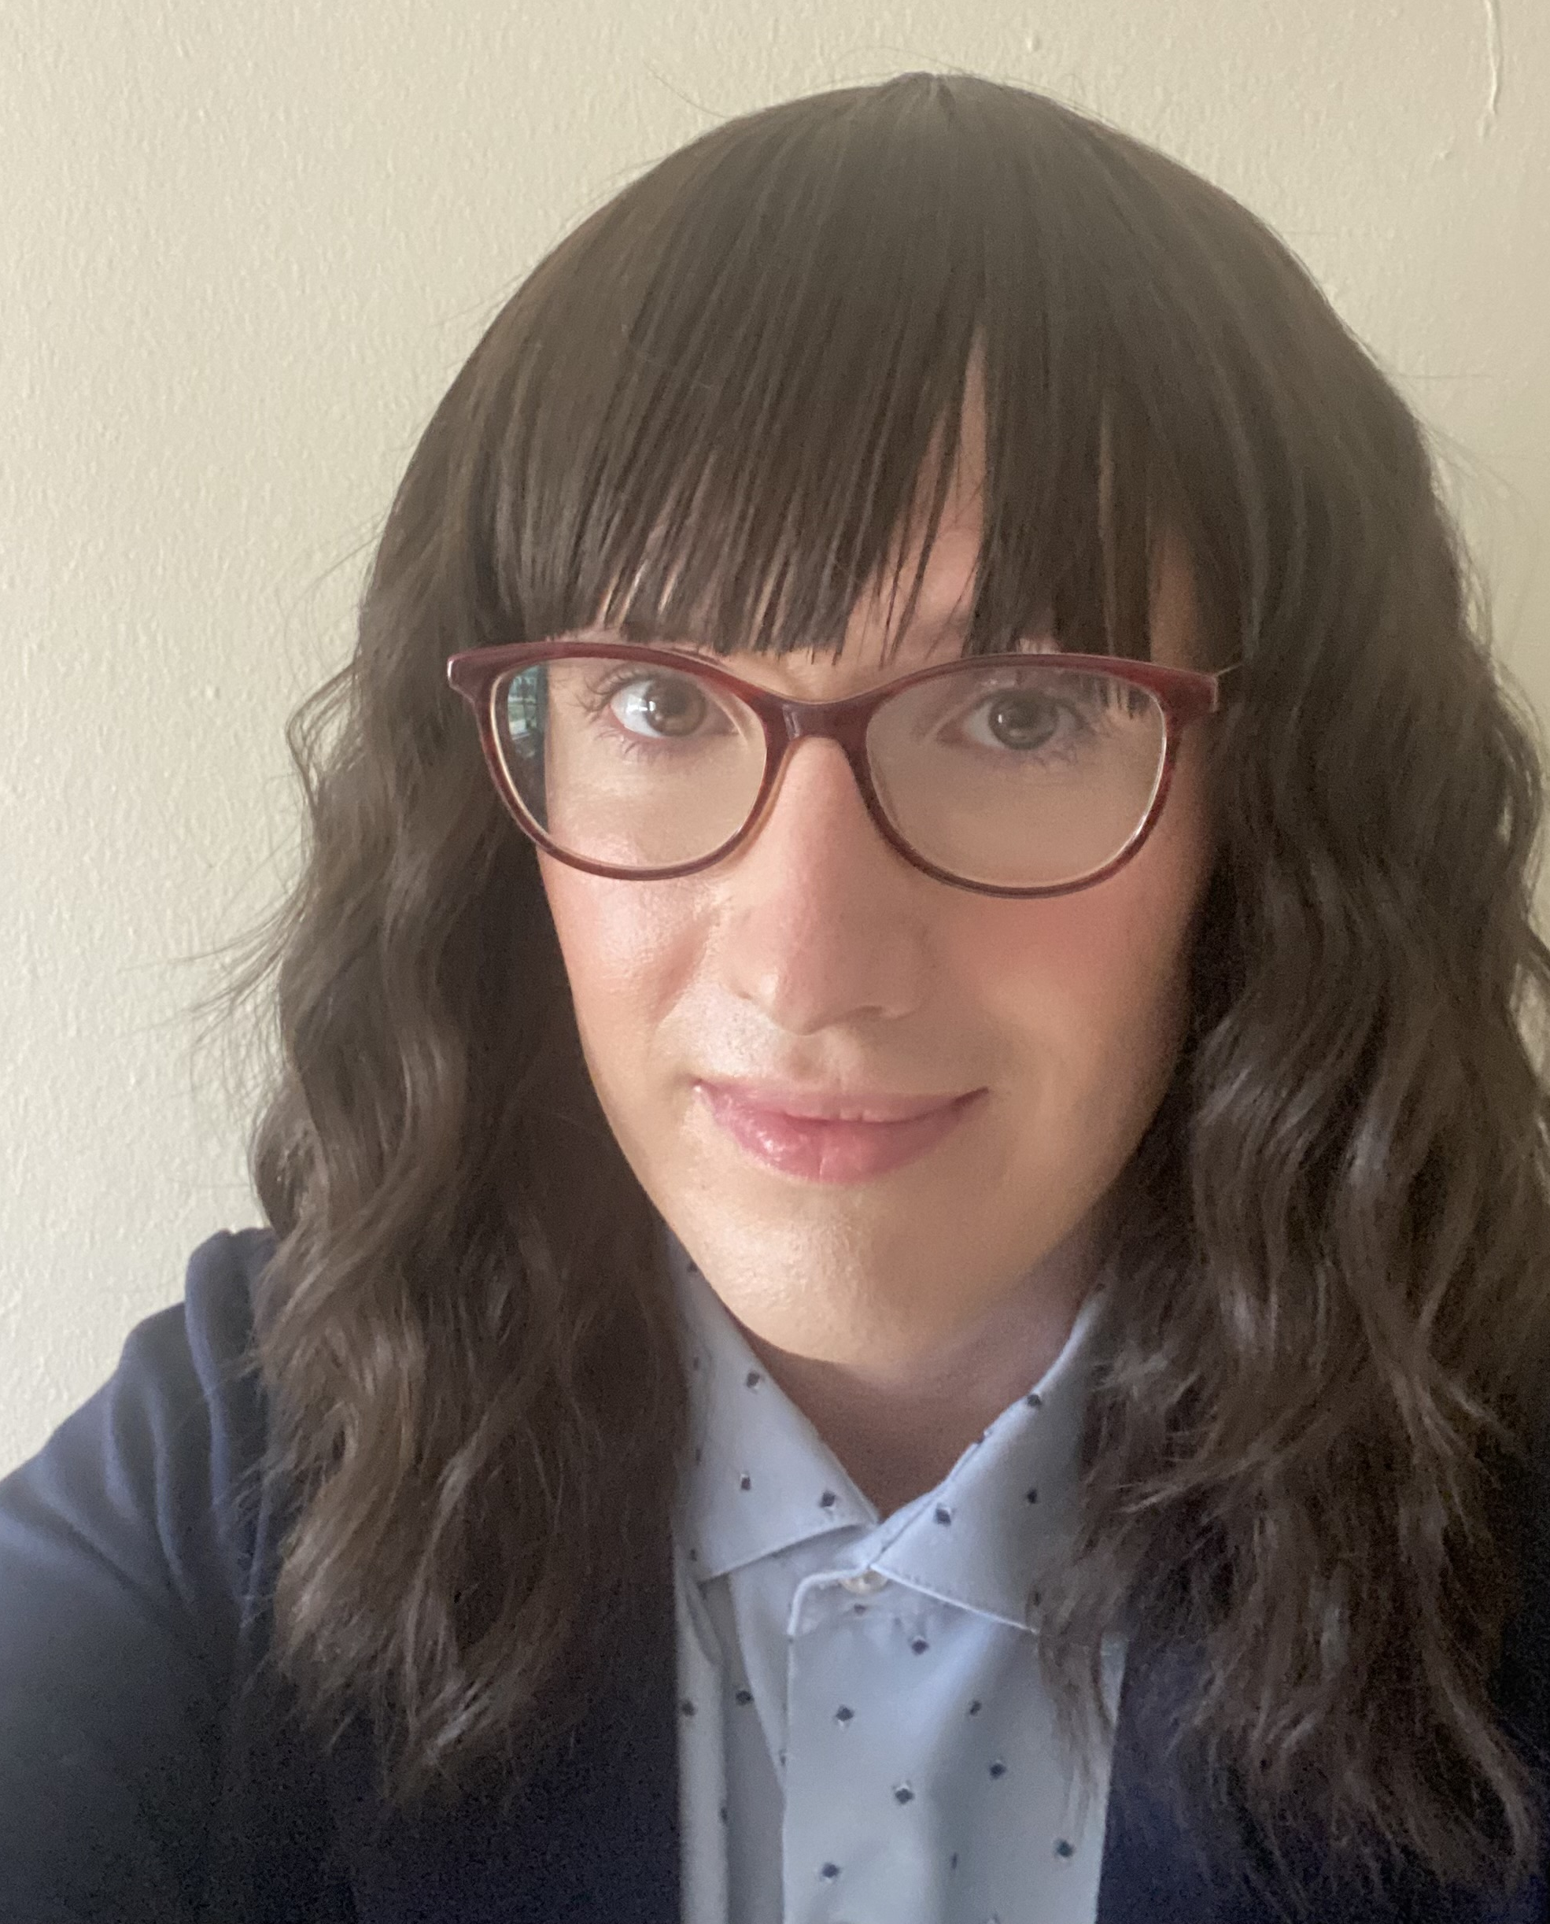
FY 2023-24 Federal Funding
Noel Benson, Fiscal Analyst

Slide 11
School Aid
$916.4 million for School Lunches
$754.7 million in Federal ESSA Grants
Includes $535.0 million in Title I funds, $100.0 million in Improving Teacher Quality funds, and $40.4 million in 21st Century Community Learning Center funds, among other grants
$390.0 million for Special Education Reimbursement
$71.0 million in Special Education Grants
$60.5 million in other Federal Grants
Includes $24.0 million in Career and Technical Education funds, $18.0 million in Preschool Development funds, $14.0 million in Public Charter Schools Program funds, among other grants
$8.0 million for Education Assessments
$193,500 for the Center for Educational Performance and Information

Slide 12
Department of Education
Estimated $313.7 million for Child Development and Care Public Assistance
$125.3 million for Administration
Includes $358,100 for Head Start Administration and $11.5 million for the Office of Great Start
$18.9 million for Child Development and Care Contracted Services
Includes funds for the Early Childhood Investment Corporation and License Exempt Monitoring

Slide 13
Department of Health and Human Services
Estimated $5.3 billion for Supplemental Nutrition Assistance Program (SNAP)
Estimated $61.5 million for Temporary Assistance for Needy Families (TANF)
Estimated $170.5 million for Women, Infants, & Children (WIC)

Slide 14
For more information:
HFA Resources
http://www.house.mi.gov/hfa/SchoolAid.asp
https://www.house.mi.gov/hfa/Education.asp
https://www.house.mi.gov/hfa/HealthandHumanServices.asp
Contact Information
Noel Benson, Fiscal Analyst
nbenson@house.mi.gov
(517) 373-8080

Slide 15
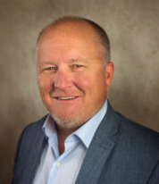
Panel Talk with Matt Gillard
Q. What’s at stake?
Q. What’s the relationship between federal revenues to the state budget? What does it mean for Michigan?
Q. What can we do? Suggestions for advocacy?
Q. How does the federal budget process traditionally work? How is it working out today?
Q. What are the power dynamics at play?
Q. What trends have we seen emerge in federal budget funding?

Slide 16
In Closing:
Look for resources & panelist bios on the Lunch & Learn page under Resources at www.Michiganschildren.org
Join us for our next Lunch & Learn on Wed. Sept. 20th
Watch/listen to our next Podcast episode of Speaking for Kids!
Join us for “Fore the Win: Michigan’s Children Putt Putt Classic” fundraiser on Sept. 13. Look for it under Events at
www.Michiganschildren.org

Slide 17
Thank you for being here today! Please advocate for federal funding for Michigan’s Children kids & families.

