Slide 1
The FY24 State Budget: Now’s the Time for Children’s Advocates to Raise Your Voices
Michigan’s Children Lunch & Learn
May 24th, 2023

Slide 2
Today’s Agenda
Welcome
Stephen Wallace, Regional Engagement and Mobilization Associate, Michigan’s Children
Children Advocates, It’s Time to Raise Your Voices
Matt Gillard, President & CEO, Michigan's Children
It’s Time to Raise Your Voices
Guest Panel
Erica Willard, Executive Director, Michigan Association for the Education of Young Children
Ty Forquer, Strategic Manager, Michigan College Access Network
Rachel Richards, Fiscal Policy Director, Michigan League for Public Policy
Notes:
Teri offers Upcoming programmatic news.
Last L&L of the year
Please revisit our L&L programs and Podcasts to learn more about . 30 guests over the p[ast year

Slide 3
Find recorded programs you missed,
or want to review again!
https://www.michiganschildren.org/2020-2022-lunch-learn/
Topics: Issue Advocacy, Budget Advocacy, Election advocacy
Issues: Early Childhood, Home Visiting, Kids’ Mental Health, State Tax Plans and Budget Planning, the Provider Workforce Crisis
Notes:
Re-vist a slew of programs from the year. Don’t forget to catch our podcast too. Sign up for our bulletin on the website . Always looking for presenters/panelists and topics. Send us yours.
Podca
https://www.michiganschildren.org/michigan-children-e-bulletin/st – under the resource tab https://www.michiganschildren.org/speaking-for-kids-the-podcast/

Slide 4
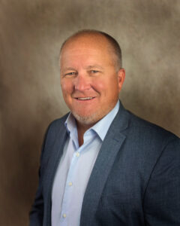
It’s Time to Raise Your Voices

Slide 5
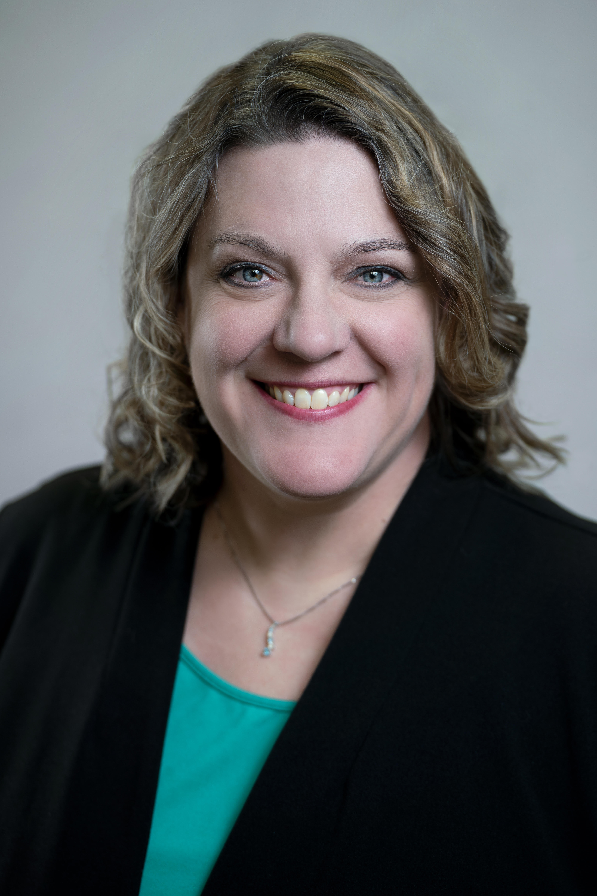
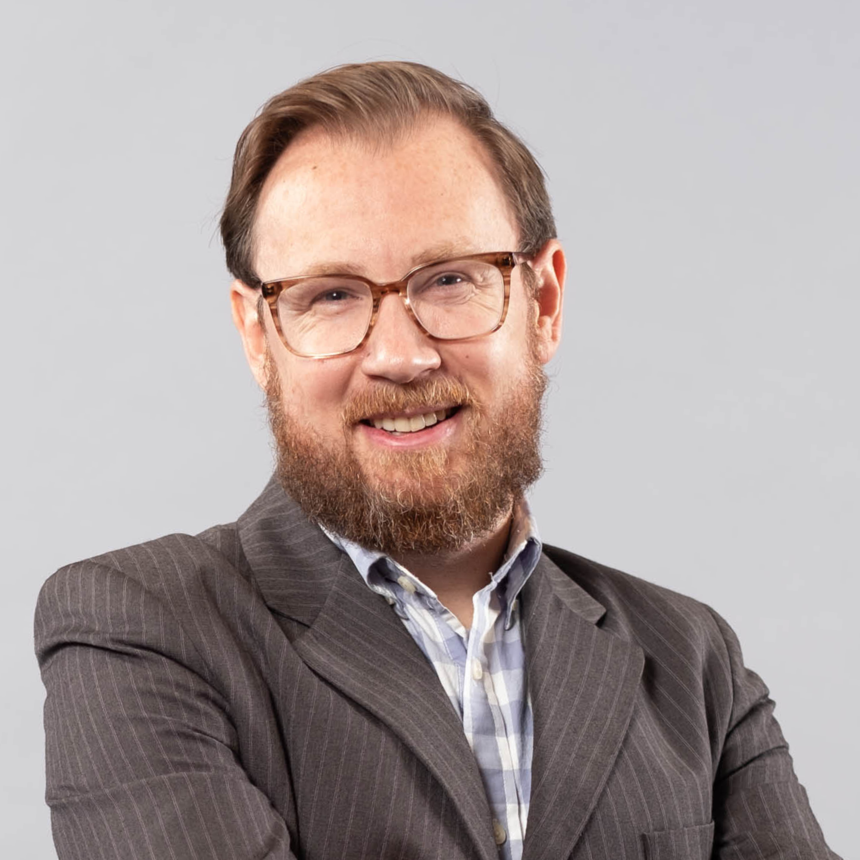
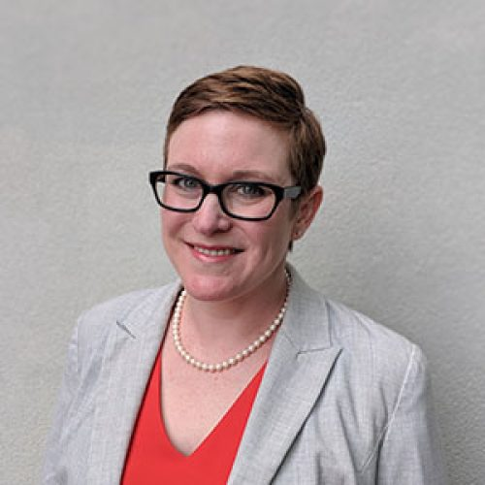
Our Panel of Pundits
Erica Willard, Executive Director, Michigan Association for the Education of Young Children
Ty Forquer, Strategic Manager, Michigan College Access Network
Rachel Richards, Fiscal Policy Director, Michigan League for Public Policy

Slide 6
What questions do you have?
Please type your questions in the chat or raise your hand to be called on.

Slide 7
Visit us! Sign-Up for our twice-a-month e-bulletin
Join our monthly Lunch & Learns on important topics for advocates
Subscribe to our podcast to hear directly from decision-makers and powerful grassroots voices
Email us with any specific questions you have.

Slide 8
Thank you for being here today! Remember to visit our website for recordings of these & other programs. Find them under the Resource tab. www.michiganschildren.org

