Slide 1
These Capital Days: Coming to Lansing, and Bringing Your Ask
Michigan’s Children Lunch & Learn
March 22nd, 2023

Slide 2
Today’s Agenda
Welcome
Stephen Wallace, Regional Engagement and Mobilization Associate, Michigan’s Children
Coming to Lansing, and Bringing Your Ask
Teri Banas, Director of Programs, Michigan's Children
How we can help stage a Capitol Day
Bobby Dorigo Jones, Vice President, Michigan's Children
How we can help you plan your budget ask
Guest Panel
Karyn Goven, Vice President, Michigan Adult, Community and Alternative Education Association
Alicia Guevara Warren, Senior Director of Policy and Advocacy, Early Childhood Investment Corporation
Ben Moe, Board President, Michigan Network for Youth and Families
Brooke Van Prooyen, Community Engagement & Support Manager, Adoptive Family Support
Kadi Prout, Associate Executive Director, Michigan Federation for Children & Families
Notes:
Teri offers Upcoming programmatic news.
Last L&L of the year
Please revisit our L&L programs and Podcasts to learn more about . 30 guests over the p[ast year

Slide 3
Notes:
Please look for emails/updates … check your junk file box. Registration closing tomorrow. 240 registered. Expecting a great celebration of the good work people are doing in their communities across the state on behalf of children, youth and families.

Slide 4
Find recorded programs you missed,
or want to review again!
https://www.michiganschildren.org/2020-2022-lunch-learn/
Topics: Issue Advocacy, Budget Advocacy, Election advocacy
Issues: Early Childhood, Home Visiting, Kids’ Mental Health, State Tax Plans and Budget Planning, the Provider Workforce Crisis
Notes:
Re-vist a slew of programs from the year. Don’t forget to catch our podcast too. Sign up for our bulletin on the website . Always looking for presenters/panelists and topics. Send us yours.
Podca
https://www.michiganschildren.org/michigan-children-e-bulletin/st – under the resource tab https://www.michiganschildren.org/speaking-for-kids-the-podcast/

Slide 5
Help for Staging Your Capital Day
Support for planning your event
Creating a plan/outline
Talking through objectives, messaging, speakers
Designing your program
Pre-event advocacy training and coaching:
ie. How to talk to Lawmakers
Getting the Word Out
Communications pieces, Media support, Promotions
Issue-oriented news releases that get attention
Media outreach
Teri Banas, Director
of Programs and Communication, Michigan’s Children
Notes:
We have lots of resources to share. We can talk more indepth about this. Relationships need tending all year round. Cap Days are just the beginning. Think of it as a way to touch base with those who care about your community like you do. If you just see someone when you want something, well, that’s not how to do advocacy.

Slide 6
Help for Staging Your Capital Day
The Day of …
Guiding attendees to legislative office buildings
Introducing, connecting lawmakers and staff w/ attendees
at lunch time
Helping pulling lawmakers “off the floor” when in session
Notes:
We have lots of resources to share. We can talk more indepth about this. Relationships need tending all year round. Cap Days are just the beginning. Think of it as a way to touch base with those who care about your community like you do. If you just see someone when you want something, well, that’s not how to do advocacy.

Slide 7
Planning a Budget Ask for Your Capital Visit
Build a statement of need
$$ needed to achieve a certain goal
How can you prove this is worth it?
Outcome
Research
Evaluation data
Who needs to be supportive or neutral?
Who needs to be on-board or at least not opposed
Bobby Dorigo Jones,
Vice President,
Michigan’s
Children

Slide 8
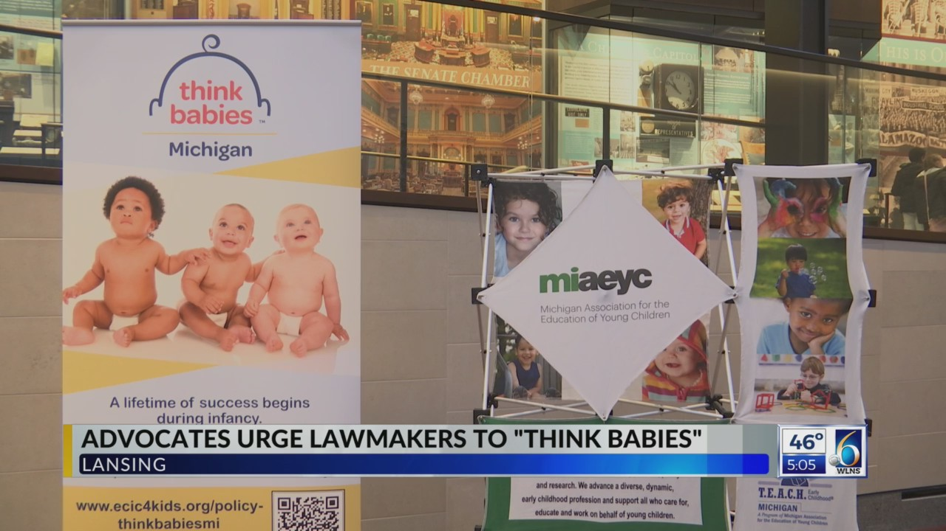
Capital Day in Action: MAEYC and ECIC’s Recent Legislative Visit
https://www.wlns.com/video/advocates-urge-lawmakers-to-think-babies/8475129/

Slide 9
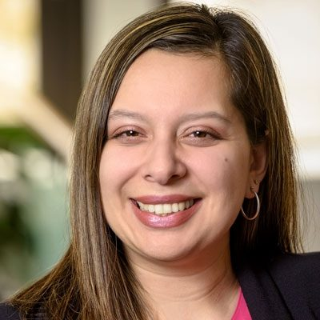
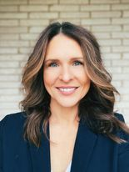
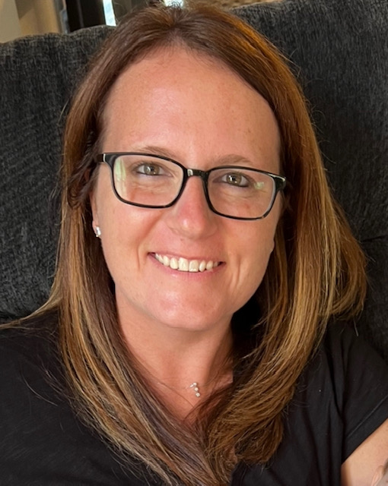
Our Panel of Pundits
Karyn Goven, Vice President, Michigan Adult, Community and Alternative Education Assoc.
Alicia Guevara Warren, Senior Director of Policy and Advocacy, Early Childhood Investment Corporation
Ben Moe, Board President, Michigan Network for Youth & Families
Karyn Goven, Vice President, Michigan Adult, Community and Alternative Education Assoc.
Brooke Van Prooyen, Community Engagement & Support Manager, Adoptive Family Support Network
Kadi Prout, Associate Executive Director, Michigan Federation for Children and Families

Slide 10
1) Question
Capital Days are about getting your people, messages and "asks" before decision-makers.
Tell us about a time - or your experiences over time - when these events have made a real difference in your budget advocacy.

Slide 11
2) Question
What are 2-3 suggestions or tips for organizing a winning Capital Day?
What's in the secret sauce?

Slide 12
3) Question
Every event offers new learnings to build from.
Please share some pitfalls to avoid when organizing a Capital Day event?

Slide 13
4) Question
What's the biggest lift - hardest, most time-consuming aspect of planning a Capital Day?

Slide 14
5) Question
How have Capital Days directly impacted your organization's work?

Slide 15
What questions do you have?
Please type your questions in the chat or raise your hand to be called on.

Slide 16
Visit us! Sign-Up for our twice-a-month e-bulletin
Join our monthly Lunch & Learns on important topics for advocates
Subscribe to our podcast to hear directly from decision-makers and powerful grassroots voices
Email us with any specific questions you have.

Slide 17
Thank you for being here today! Remember to visit our website for recordings of these & other programs. Find them under the Resource tab. www.michiganschildren.org

