Slide 1
Governor Whitmer’s FY2023-24 Budget: What’s in it for Kids and Families
Michigan’s Children Lunch & Learn
February 15th, 2023

Slide 2
Today’s Agenda
Welcome
Stephen Wallace, Regional Engagement and Mobilization Associate, Michigan’s Children
What’s in it for Kids and Families?
The Budget Process, Michigan League for Public Policy
Maddie Elliott, Policy and Programs Associate
Early Childhood Impact
Bobby Dorigo Jones, Vice President, Michigan’s Children
Youth and Family Highlights
Matt Gillard, President & CEO, Michigan’s Children
What happens next ?
Q/A: Audience questions
Notes:
Teri offers Upcoming programmatic news.
Last L&L of the year
Please revisit our L&L programs and Podcasts to learn more about . 30 guests over the p[ast year

Slide 3
Notes:
Mark your calendar. Registration will open this week. Offer an overview

Slide 4
Revisit last Year’s Programs
https://www.michiganschildren.org/2020-2022-lunch-learn/
Topics: issue advocacy, budget advocacy, election advocacy
Issues: early childhood, home visiting, kids’ mental health, state tax plans and budget planning, the provider workforce crisis
30 guest panelists and pundits
Your favorite Michigan’s Children people ☺
Notes:
Re-vist a slew of programs from the year. Don’t forget to catch our podcast too. Sign up for our bulletin on the website . Always looking for presenters/panelists and topics. Send us yours.
Podca
https://www.michiganschildren.org/michigan-children-e-bulletin/st – under the resource tab https://www.michiganschildren.org/speaking-for-kids-the-podcast/

Slide 5
The Budget Process
Budget Basics – MLPP

Slide 6
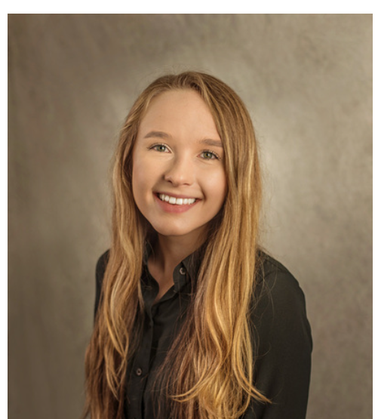
Early Childhood Highlights
Pre-K for all 4-year-olds
Child care
Workforce supports
Healthy early development – Early On and Home Visiting
Madeline Elliott
Policy and Programs
Associate

Slide 7
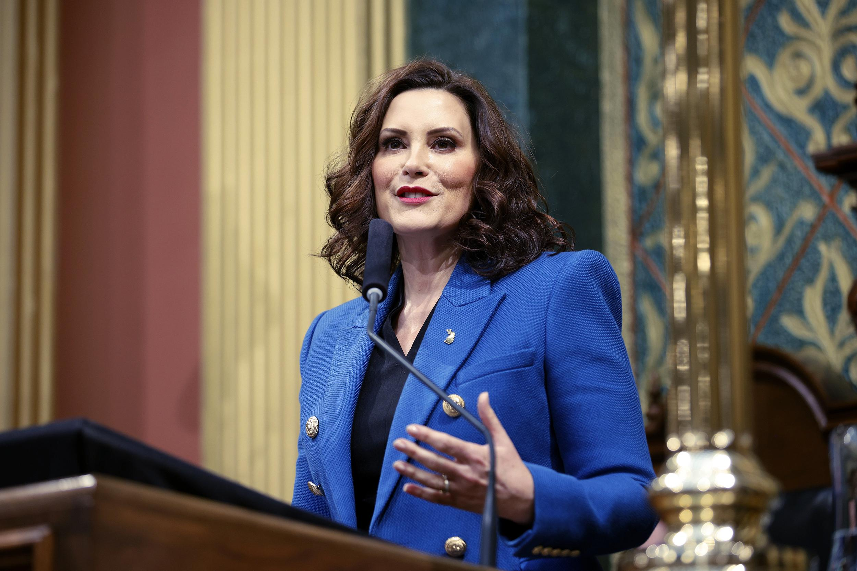
Preschool for All 4-Year-Olds
By the end of the Governor’s second term
Support preK expansion in school-based and community-based classrooms
Expand eligibility for GSRP from 250% of the federal poverty limit to 300%
Increasing the per pupil amount from $9,150 to $9,608
Notes:
The Executive Recommendation proposes the first step
Set eligibility at 300% FPL with ability to serve up to 400%
piloting more classes for 3-year-olds
creating new or expanded programs
serve 5,600 additional kids
$75M for grants to shift to 5 days a week and blend preK and child care funds to offer year-round options (one-time)

Slide 8
Preschool for All Continued
Expanding the number of days covered by GSRP
$50M start up grants for 2,000 new classrooms (one-time; work project)
$10M for an outreach campaign (one-time)
$18M for transportation (ongoing)

Slide 9
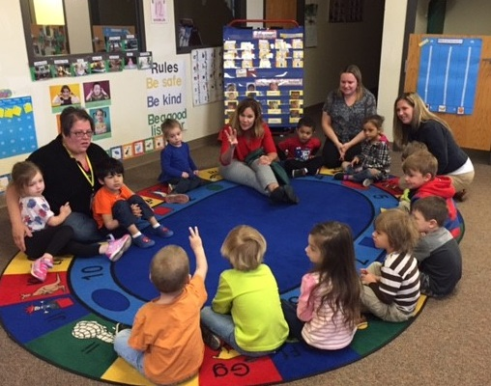
Child Care Highlights
$50M to grow the early childhood workforce
create a needs assessment
navigation services for workforce - increased recruitment
strengthen career pathways
training and credentialing options
pilot strategies to recruit and retain workforce
$24M for a refundable income tax credit for early childhood educators - $1-3,000
child care, preschool, and after-school programs
To qualify, professionals must:
Work in licensed child care facility that participates in Great Start to Quality
Work at least part time (1,040 hours in a year)
Participate in the Registry
Notes:
Credit has three levels. Allows MDE to set qualifications based on education and experience.

Slide 10
Child Care Highlights Continued
Maintain eligibility at 200% fpl (ongoing)
$7.5M increase for Great Start Collaboratives (total of $18.4M)
$900,000 increase for Tri-Share ($3.5M total; ongoing)
Maintain payment rates and structure--including enrollment vs attendance (ongoing)
Maintain infant and early childhood mental health consultation ($3M; ongoing)

Slide 11
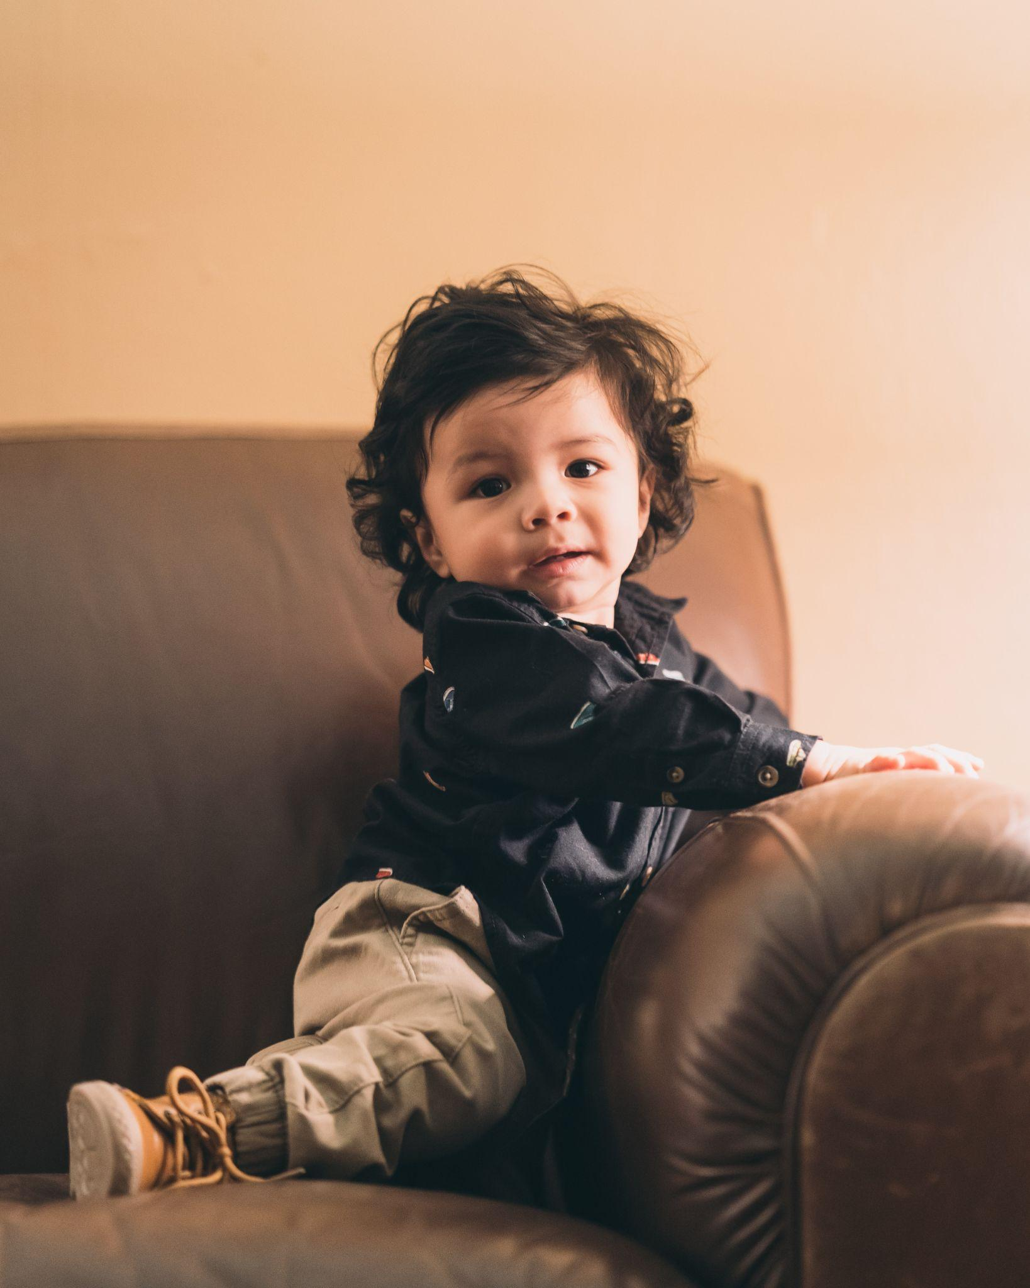
Healthy Development
$31.4M increase for Healthy Moms, Healthy Babies
$2M increase for school-based home visiting programs
$2M increase for voluntary home visiting programs
$1M increase for Early On (ongoing; total $22.3M)

Slide 12
Youth and Family Highlights
Juvenile Justice
Adult Education
K-12 and Afterschool
Foster Care and Homelessness
Bobby Dorigo Jones,
Vice President, Michigan’s Children

Slide 13
Juvenile Justice
Budget proposal follows the Task Force on Juvenile Justice Reform
$39 million to incentivize counties to choose community-based programs for young people instead of detention
$5 million to create a Juvenile Justice Services Division and investigate complaints in detention facilities
$500,000 to expand legal representation for families who cannot afford it
$3 million to resentence juvenile life sentences

Slide 14
Adult Education
Historic $15 million increase for Adult Education and family literacy programs
Over 40,000 Michiganders aged 18-34 do not have a high school diploma
13,000 babies each year are born to a parent who did not finish high school

Slide 15
K-12 and Afterschool
5% increases to “weights” for economically disadvantaged, bilingual learners – but mostly equal with increases in the base foundation
$80 million to increase special education from 75% to 87.5% of the base funding weight
Nearly $1 billion combined for school infrastructure, wraparound services, early literacy
Continued $25 million for out-of-school-time learning, far below the estimated need

Slide 16
Foster Care & Homelessness
8% increase to foster family payments & expanding respite care
No investment dedicated to supporting informal kin
No investment in supports dedicated for older youth experiencing homelessness
No investment into specific transition supports for older youth exiting foster care

Slide 17
What’s Next?
The ball is now in the Legislature’s court
Your legislators need to hear from you
The Governor’s budget proposal should be viewed as the floor
Final FY24 budget presented to the Governor by July 1st
Matt Gillard,
President & CEO,
Michigan’s Children

Slide 18
Questions?
Please either type your questions in the chat, or raise your hand to be called on.

Slide 19
Visit us! Sign-Up for our bi-weekly bulletin
Join our monthly Lunch & Learns on important topics for advocates
Subscribe to our podcast to hear directly from decision-makers and powerful grassroots voices
Call us with any specific questions you have!

