Slide 1
It’s a Lame, Lame Duck (at least on the State side)
Michigan’s Children Lunch & Learn
December 14, 2022

Slide 2
Today’s Agenda
Welcome
Teri Banas, Director of Programs & Communications, Michigan’s Children
A Tale of Two Lame Ducks
Bobby Dorigo Jones, Vice President, Michigan’s Children
What happened – and didn’t – during the state Legislature’s Lame Duck
Matt Gillard, President & CEO, Michigan’s Children
Lame Duck action in the nation’s Capitol and what child and family advocates should know
Q/A: Audience questions
Notes:
Teri offers Upcoming programmatic news.
Last L&L of the year
Please revisit our L&L programs and Podcasts to learn more about . 30 guests over the p[ast year

Slide 3
Notes:
Mark your calendar. Registration will open in early 2023.

Slide 4
Revisit this Year’s Programs
https://www.michiganschildren.org/2020-2022-lunch-learn/
Topics: issue advocacy, budget advocacy, election advocacy
Issues: early childhood, home visiting, kids’ mental health, state tax plans and budget planning, the provider workforce crisis
30 guest panelists and pundits
Your favorite Michigan’s Children people ☺
Notes:
Re-vist a slew of programs from the year. Don’t forget to catch our podcast too. Sign up for our bulletin on the website
Podca
https://www.michiganschildren.org/michigan-children-e-bulletin/st – under the resource tab https://www.michiganschildren.org/speaking-for-kids-the-podcast/

Slide 5
The State Legislature’s Lame Duck that Was
Mental Health
Two proposals to reform the Mental Health Administration
died in Lame Duck, despite promises of a compromise.
Yet, the Need for Reform is Long-standing and Continues.
Driving the issue:
Public dissatisfaction with availability of mental health services
Court settlements focused on Medicaid mental health
40% of children with common behavioral health diagnoses do not receive care for them
Bobby Dorigo Jones,
Vice President, Michigan’s Children

Slide 6
The State Legislature’s Lame Duck that Was
Mental Health
The need for reforms will most likely carry the issue into the new session.
Possible Actions
Funding to expand services
Funding to grow the workforce
Reforms to make sure children and family needs are centered
Bobby Dorigo Jones,
Vice President, Michigan’s
Children

Slide 7
The State Legislature’s Lame Duck that Was
EITC
Pre-election, when divided government was expected, a big tax reform deal targeted towards people struggling the most was seen as likely - 60% of Michigan households struggle to afford their basic needs.
Post-election, Democrats knew they would be able to reform taxes next year on their own terms, and "give" vulnerable new members a vote on a popular issue.
EITC will likely pass next year.
However, families will likely wait another year to benefit from it. Specifics will depend on whether Congress reforms the federal EITC in Lame Duck.
Bobby Dorigo Jones,
Vice President, Michigan’s Children
Notes:
Michigan’s Earned Income Tax Credit is currently at 6% of the federal credit . MC and our coalition would like to see it increase to 30%

Slide 8
Just in … Last night in Congress . . .
New Framework for Bipartisan Spending Bill
Funding for the federal government is set to run out on Friday, Dec.16th
Congress is looking to pass a one-week continuing resolution (CR) today that will extend government funding through next Friday, Dec. 23^{rd.}
Last night a framework for a budget to fund the federal government through Sept.30, 2023 was agreed to by Senate Dems & Republicans, and House Dems.
Negotiations will continue around the clock on details of the federal budget and potential riders from now until it is passed, probably on the 23rd.
Matt Gillard,
President & CEO,
Michigan’s Children

Slide 9
Congress and its Unfinished Business
Last Push for the Expanded Child Care Tax Credit
Congress is revisiting the child tax credit, though efforts by Congressional champions to see it expanded will take compromise and may not be as generous as in 2021 under the American Rescue Plan.
That credit lapsed in December 2021. Its impact: A historic decline (by over 40%) in the child poverty rate. Millions of kids were lifted out of poverty as families received monthly checks.
Reinstating and expanding it is favored by many Democrats.
Matt Gillard,
President & CEO,
Michigan’s Children

Slide 10
Congress and its Unfinished Business
The Expanded Child Care Tax Credit (cont.)
In 2021, the credit was increased from $2,000 per child to up to $3,600 per child under 6 and up to $3,000 for children ages 6 through 17.
Half of those sums were made available through monthly payments. Eligible parents received the rest of the credit when they filed their tax returns.
As a high priority issue for many members of Congress, it will remain a high priority issue next year, if not acted on during Lame Duck.
Current considerations: An income phase-in and maintaining an incentive for labor force participation. Possibly indexing the credit to inflation.
Matt Gillard,
President & CEO,
Michigan’s Children

Slide 11
Congress and its Unfinished Business
Earned Income Tax Credit
The Earned Income Tax Credit (EITC) was also expanded in 2021, but it’s expired.
It was responsible for lifting 114,000 Michigan kids out of poverty.
It was also temporarily expanded to include 571,000 working adults without children, including young adults ages 18 to 24
Now Congress is looking at expanding the federal EITC in a year-end spending bill.
If adopted, would bring a tax cut to nearly 750,000 Michigan families in 2023.
Matt Gillard,
President & CEO,
Michigan’s Children
Notes:
he child tax credit was increased in 2021 from $2,000 per child to up to $3,600 per child under 6 and up to $3,000 for children ages 6 through 17. Half of those sums were made available through monthly payments of up to $300 per child under 6 and $250 per child ages 6 through 17. Eligible parents received the rest of the credit when they filed their tax returns.

Slide 12
Questions?
Please either type your questions in the chat, or raise your hand to be called on.

Slide 13
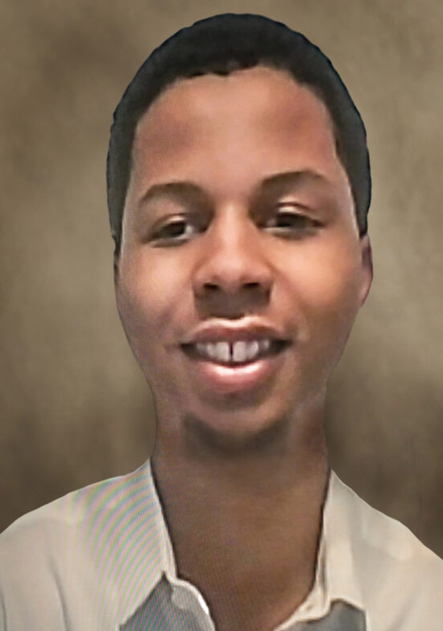
Happy Holidays from Michigan’s Children!

