Slide 1
“What Just Happened?”
The November 8th Midterm Election Results.
What They Mean for Moving Issues for Kids & Families
in 2023?
Michigan’s Children’s Lunch and Learn Program
November 16, 2022
Prepared by Program Director Teri Banas, Michigan’s Children
Notes:
Welcome everyone to today’s Lunch & Learn program – What Just Happened – as we welcome several special Lansing insiders to break down the Results of the mid-term election, and how what happened can inform our advocacy work with the Administration and lawmakers in the new session.
Today you’ll hear from four distinguished Capitol lobbyists who work in areas close to our hearts and work – veteran lobbyists Andrea Cascarilla, Jean Doss, Matt Kurta, and Christin Nohner.

Slide 2
The Agenda “What Michigan’s Midterm Elections Brought: A Trifecta” Teri Banas, Director, Programs and Communications, Michigan’s Children “A Child Advocates View of Advocacy Opportunities Ahead” Maddie Elliott, Early Childhood Policy Associate, Michigan’s Children Panel Talk: “What Just Happened? The View from 4 Lansing Insiders” Andrea Cascarilla, Dykema Jean Doss, Capitol Services Matt Kurta, Karoub and Associates Christin Nohner, McCall Hamilton Q/A Audience Conclusion
Notes:
But first, I’ll run through the Basics, who won, whose moving into Leadership positions in the Legislature. Maddie Elliott, our early policy associate, and will offer her perceptions on opportunities for child care in the new session. Then we’ll bounce over to our panelists..

Slide 3
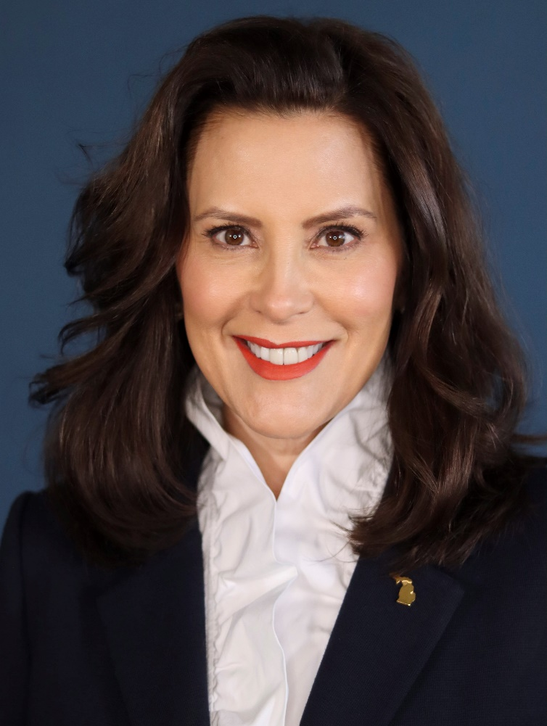
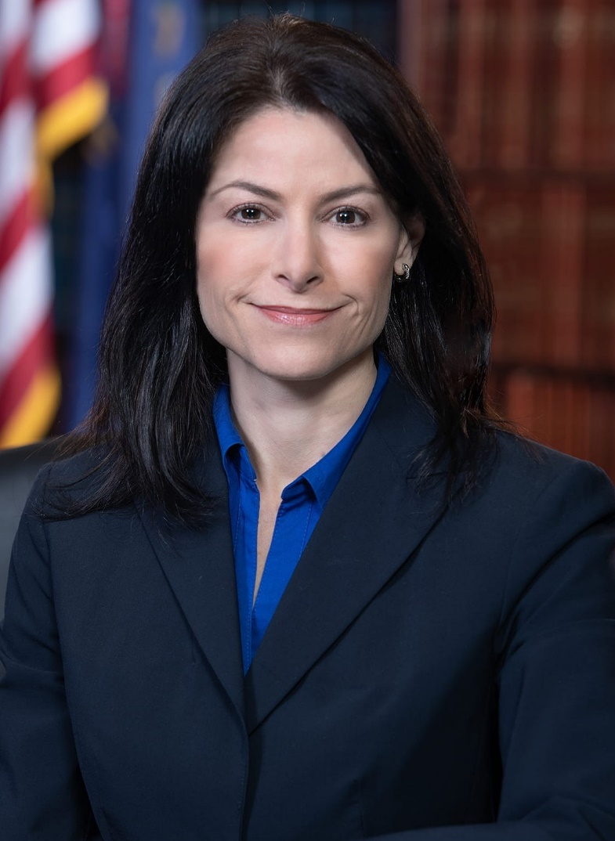
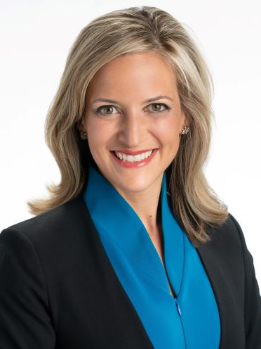
A Trifecta: A Democratic Governor, Attorney General, and Secretary of State
Gov. Gretchen Whitmer AG Dana Nessel SOS Joselyn Benson
Notes:
As you saw, Democrats Gov. Whitmer, Attorney General Dana Nessel and Secretary of State Joselyn Benson at the top of the ticket all easily won re-elected in contests against Republican candidates that had campaigned with endorsements from Donald Trump.
In races watched closely across the country, Democratic candidates won both chambers of the State Legislature for the first time in 40 years – a historic outcome – though however with razor thin margins.
It was a Trifecta win for the Democrats with additionally all 3 state proposals passing as well. Voters approved ballot measures for Term Limit Reforms, Voting Rights, and Reproductive Rights.
There were a lot of Firsts election night – starting with the fact that 4.5 million votes were cast making this the highest turnout in a midterm election in the history of the state. This represented nearly 62% of registered voters.
While democrats were energized around the issue of abortion and many were angered by the political extremism in recent years as well as political violence – that manifested at home with the foiled kidnapping plot of Gov. Whitmer - According to press accounts, Republican turnout was down in every county in Michigan compared to 2020.

Slide 4
The Balance of Power in the 102nd Legislature
The Michigan Senate
20 Dems 18 GOPs
The Michigan House
56 Dems 54 GOPs
Notes:
In outcomes from legislative races, we saw:
20 Democrats and 18 Republicans elected to the state Senate
56 Democrats and 54 Republicans elected to the state House
54 total winners who are new to state-level elected office
With the passing of term limit reform, legislators now will have fewer total years to stay in office (12 down from 14) … that’s if they continue to be re-elected (every two years from House members, every 4 years from Senators)
But they will be allowed more possible years to serve in one chamber – from 6 to 12 in the House, and from 8 to 12 in the Senate
Also important to remind you that because of redistricting this year, Every elected official is either new to the state legislature altogether or representing a new area
With new officials conceivable in their seats for over 10 years, this is an opportunity to build stronger champions.

Slide 5
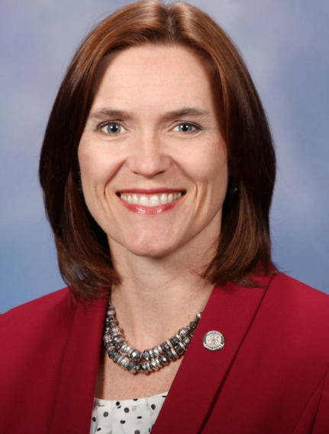
The Next Senate Majority Leader:
Winnie Brinks, D-Grand Rapids
Notes:
So let’s look at who will be in Leadership come January. And some more Firsts, particularly as they relate to Diversity and Inclusion.
Winnie Brinks, Democrat from Grand Rapids.
First woman to lead either chamber in the history of the Michigan Legislature.
First Democrat to lead the Senate since 1983
Said they're ushering in a new period after 40 years of pent up policy.
She’s said in press reports that the party’s top priorities were economy, education and reproductive rights. That is, creating good-paying jobs, safe work environments, making health care accessible and affordable, delivering a world-class public education to kids, and ensuring equality for all are just some of the fundamental values we will uphold.”
History note: This Kent County Democrat started her career as a write-in candidate and won a House seat in 2012.

Slide 6
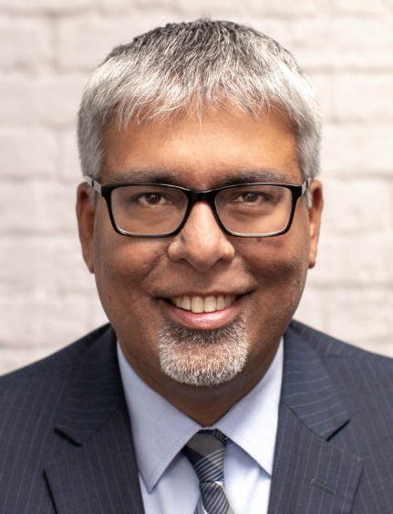
The Next Senate Majority Floor Leader
Sam Singh, D-East Lansing
Notes:
First Indian-American leader in the state Senate.
Last served as the Minority Leader in the state House until he was termed out four years ago. (House member 2013-2018). Former mayor of East Lansing.
Strong leadership pedigree in the public policy, philanthropic and nonprofit sector. He was the CEO of Public Policy Associates from 2019.
And the President/CEO of the Michigan Nonprofit Association. Served on 20 nonprofit boards in the past decades, and was a Governor’s appointee to the Michigan Community Service Commission. He knows where many of us are coming from.
Also served on immigrant issues in SE Michigan and Lansing.

Slide 7
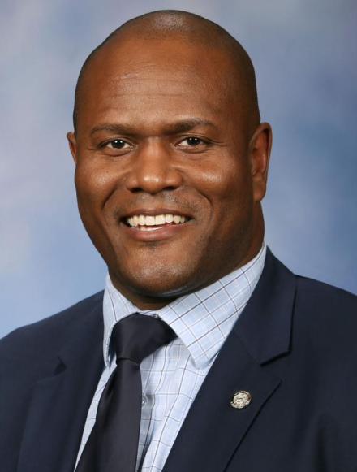
The Next Speaker of the House
Joe Tate, D-Detroit
Notes:
First African-American lawmaker elected Speaker of the House. Elected to the House from 2nd District, and now reelected from the redrawn 10th District. Encompassing east Detroit and the Gross Pointes
Tate is considered a moderate Dem, and in the contest to become the next Speaker he emerged to the top seat after receiving strong labor support, and besting progressive lawmaker Felicia Brabec, a social worker from Washtenaw County.
As a legislative leader and Detroiter, it’s important to note that he is publicly committed to Detroit and its resurgence, linking the city’s future to Michigan’s. “A successful Detroit leads to a successful Michigan,” he’s said.
Tate has a made-for-the-movies bio. A native Detroiter, his mom was a Detroit schoolteacher, and his dad was a firefighter, who died on the job for the city.
Former NFL football player, who left professional ball to serve in the U.S. Marines. He served the nation, with two tours in Afghanistan, overseeing the day-to-day operations of hundreds of fellow Marines. As a professional athlete, he spent two years in the NFL and last played for the Atlanta Falcons.
In his early days, he attended Michigan State on an athletic scholarship, studying public policy. He also played in the Spartans Football Program, becoming a team captain in his senior year. He has two master's degrees, from the UM, an MBA and a Master’s in Science (Environmental Policy and Planning)
https://www.tateformichigan.com/meet-joe-tate

Slide 8
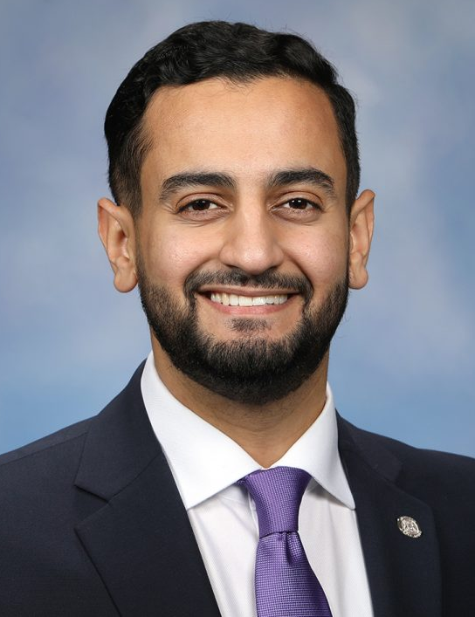
The Next House Majority Floor Leader
Abraham Aiyash, D-Hamtramck
Notes:
First Muslin-American in this position. A progressive. Son of immigrants from Yemen, raised in Hamtramck by parents worked as a homemaker and UAW member
Started as community organizer for Pres. Obama’s historic 2008 campaign. Reelected to a second term, this time in the reorganized 9th district.
Ran on the issues this year of defeating anti-black racism, reforming the criminal justice system, ending police brutality
MSU grant – political theory and constitutional democracy.
co-founded a nonprofit that mentored refugee children in the Lansing area. Aiyash was first exposed to legislative work when he served under State Representative Rose Mary Robinson.
On children and family issues, supports universal pre-K, expanded/restored paid sick leave for parents, expanding child care financing.
As community leader, he was galvanized by the fight against corporate polluters, fighting against expanding a toxic waste site on the Hamtramck-Detroit border. In the fight for environmental justice, he frequently organized against corporate polluters and jump started a recycling program in his local school district.
Worked as Statewide Training and Political Leadership Director at Michigan United, Aiyash trained political leaders and informed progressive solutions for education, healthcare, immigration, criminal justice and environmental racism.

Slide 9
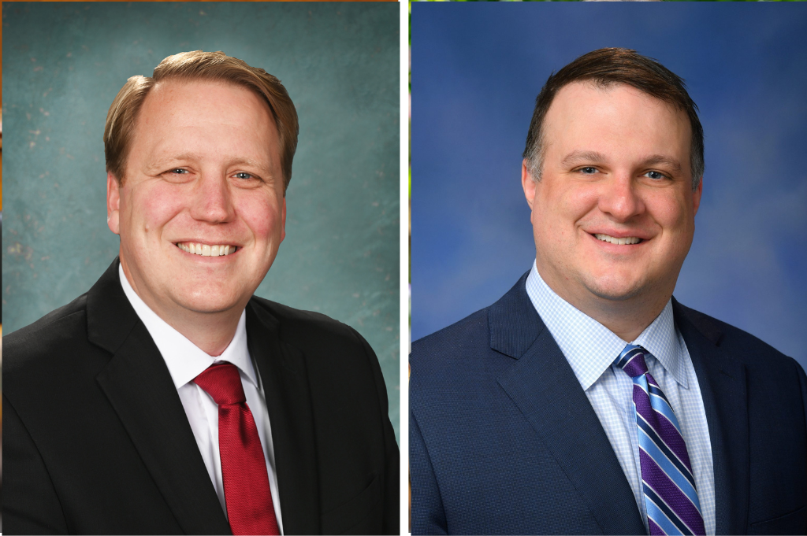
Minority Leaders of the Senate and House
Sen. Aric Nesbitt, R-Lawton Rep. Matt Hall, R-Comstock
Notes:
In Caucus voting, Aric Nesbitt was elected to be the Minority leader in the Senate. Elected to a second Senate term, this time from the newly drawn 20th district.
He had served as president pro tempore. And is known for sponsoring legislation that reformed Michigan’s car insurance system.
Nesbitt previously served three terms in the state House, where he was House majority floor leader. Previously, former Gov. Rick Snyder had appointed him a Michigan Lottery commissioner.
Nesbitt grew up on a six-generation family farm in West Michigan.
He pledged to continue positive working relationships with colleagues across the aisle.
Matt Hall, of Comstock Township, has been elected Republican leader by his House colleagues for the new term.
Hall currently serves as House Republican caucus chair and will begin his third term in the Michigan House in January serving the 42nd District, which covers parts of Kalamazoo and Allegan counties.
While leading the caucus in the new term, Hall will head up policy development, work with legislators to determine best fits for committee assignments and engage in key discussions with other state legislative leaders.
Hall currently chairs the House Tax Policy Committee, where he has worked on numerous tax relief measures, and efforts to spur job growth.
Prior to his legislative career, Hall worked as west Michigan liaison for the Michigan Attorney General Office.

Slide 10
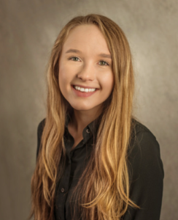
“A Child Advocates View of Advocacy Opportunities Ahead”
Maddie Elliott, Policy and Program Associate, Michigan’s Children
Notes:
Next up, I’d like to introduce Maddie Elliott, our early childhood policy associate , who’s going to spend just a couple of minutes talking about one of the seminal issues we’ve been working on that’s gotten a lot of attention from the current Legislature and Administration and from advocates here today.

Slide 11
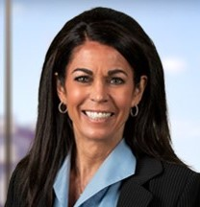
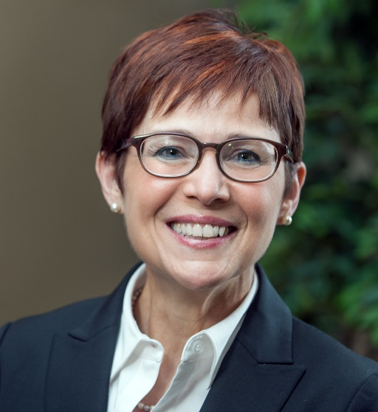
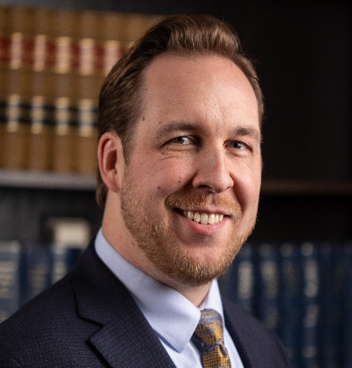
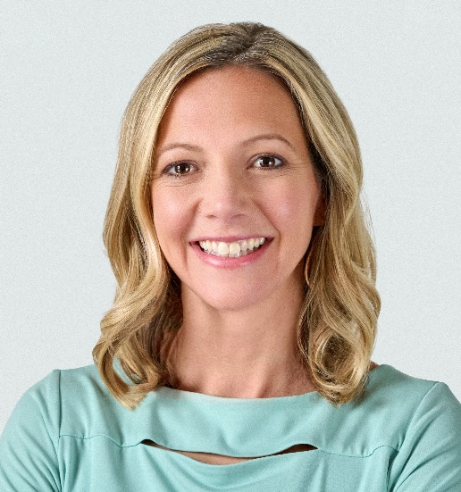
Meet our Panelists
Andrea Cascarilla Jean Doss Matt Kurta Christin Nohner
Dykema Capitol Services Karoub & Assoc. McCall Hamilton
Notes:
With us here today are Andrea Cascarellia, Jean Doss, Matt Kurta, and Christin Nohner. Thanks for being here folks.
Ask each one to Introduce themselves – something of their that brought them to their position e background and the issues they’ve worked on that intersect with children, youth and family concerns.
Thanks everyone. Great, great to have you here.
Okay. Let’s get into the questions.
First question.

Slide 12
Panel Questions
A large swath of Michigan voters and many grassroots advocates listening in weren’t alive when the Democrats were last in power in the Michigan Legislature.
In your experience as a lobbyist, and advocate for people causes, how are things going to stay the same; how are things going to be different?
Notes:
A large swath of Michigan voters and many grassroots advocates listening in weren’t alive when the Democrats were last in power in the Michigan Legislature.
In your experience as a lobbyist, and advocate for people causes, how are things going to stay the same; how are things going to be different?
Let’s start with Andrea, then Jean, Matt and Christin

Slide 13
Panel Questions
Advocates and partners we work with over the years have been fighting hard to make positive changes in areas that strengthen families and advance youth development. Kinship care, adult and career education, juvenile justice, afterschool programs, home visiting services, and all the work that’s gone into addressing child care subsidies to make care more affordable and accessible - are among these.
As advocates begin contacting new and returning legislators, what advice do you have for our advocates – or their staffs – on pitching these issues to their offices?
Notes:
Advocates and partners we work with over the years have been fighting hard to make positive changes in areas that strengthen families and advance youth development. Kinship care, adult and career education, juvenile justice, afterschool programs, home visiting services, and all the work that’s gone into addressing child care subsidies to make care more affordable and accessible - are among these.
As advocates begin contacting new and returning legislators, what advice do you have for our advocates – or their staffs – on pitching these issues to their offices?
Let’s start with Jean, Matt, Christin, then Andrea.

Slide 14
Panel Questions
Three-part question. What do you imagine the Governor’s strategy will be in crafting a new budget in the New Year?
Will she follow through on a tax cut proposal – and where do you see EITC going?
How will she move on her campaign issues such as education and family economic issues including child care and mental health?
How will she reach out to engage Republican leaders on issues such as education, child care and child welfare?
Notes:
So, what do you imagine the Governor’s strategy will be in crafting a new budget in the New Year?
Will she follow through on a tax cut proposal – and where do you see EITC going?
How will she move on her campaign issues such as education and family economic issues including child care and mental health?
How will she reach out to engage Republican leaders on issues such as education, child care and child welfare?
Let’s go with Matt, Christin, Andrea, then Jean

Slide 15
Panel Questions
Knowing what you know about the incoming Democratic Legislative Leaders – Brinks, Singh, Tate, Aiyash – and what they value, how do you anticipate they will want to make their mark?
What issues will ignite them?
Notes:
Knowing what you know about the incoming Democratic Legislative Leaders – Brinks, Singh, Tate, Aiyash – and what they value, how do you anticipate they will want to make their mark?
What issues will ignite them?
How about starting with Christin, Andrea, Jean and Matt

Slide 16
Your Questions ???
Please click on the Raise Hand Symbol if you have a question.
And Stephen or I will call on you.

Slide 17
Visit Us! Sign-Up for our bi-weekly bulletin Join our monthly Lunch & Learns on important topics for advocates Subscribe to our podcast to hear directly from decision-makers and powerful grassroots voices Call us with any specific questions you have or if you’re interested in organizing a StudentSpeak with your state legislators!
Notes:
Thank you.
That’s about all the time we have left.
Stephen, close us out with Slide 17 please.
Happy thanksgiving everyone.
April 27 – 2023 look for a notice for a Save the Date. We’re hosting a new Conference, rather Summit, named in honor of our dear colleague Michele Corey, who many of you worked with over the years.
Happy thanksgiving everyone

