Slide 1
KidSpeak, ParentSpeak, Candidates Listen
Michigan’s Children Lunch & Learn
September 21, 2022

Slide 2
Today’s Agenda
Welcome
Teri Banas, Director of Programs & Communications, Michigan’s Children
Brief Overview, Michigan’s Children’s Candidate Forums in 2022
Introduction
Matt Gillard, President & CEO, Michigan’s Children
Why Michigan’s Children partners with local groups to sponsor youth-led, family-led forums
Panel Talk: Forum Partners Speak
Aubrey Gilliland, Project Coordinator, The Children’s Center
Laura Lefever, Director, Community Projects, The Children’s Center
Sarah Britton, Director of Prevention and Re-Entry Services, Peckham Inc.
Kathy Szenda Wilson, Co-Executive Director, Pulse @ W.E Upjohn Institute for Employment Research
Q/A: Audience questions
Conclusion

Slide 3
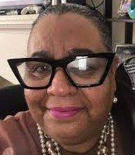
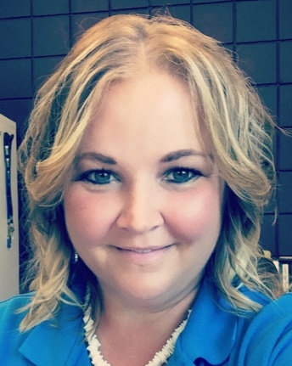
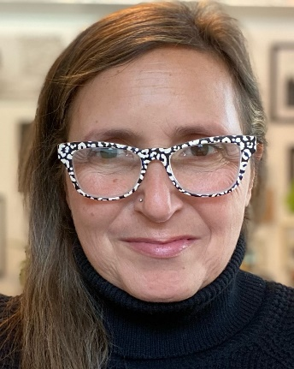
Meet our Guest Panelists
Aubrey Gilliland, Project Coordinator, The Children's Center
Laura Lefever, Director-Community Projects, The Children's Center
Sarah Britton, Director of Prevention & ReEntry Services, Peckham Inc.
Kathy Szenda Wilson, Co-Executive Director, Pulse @ the W.E. Upjohn Institute for Employment Research
You’ll hear from them soon!

Slide 4
Overview: Michigan’s Children 2022 Election Cycle Forums
Four election cycles of candidate forums featuring youth and parent voices
Young people from foster care, afterschool programs, court-involvement have contributed to forums in which candidates were pressed to understand the challenges and needs of these populations.
Adult voices have taken stage too, talking about kinship care, adult education and family prosperity, and child care.
This year, four and soon five of our forums will be early childhood focused with support from our partners at Think Babies Michigan.
All of these special focuses are designed to help potential lawmakers learn more about topics we hope they will become educated about, and willing to champion.
The voices of our forum participants are really the stars of the show for their authentic voices and real-world experiences.
Take a look at our forums and partners next week.
Notes:
https://www.michiganschildren.org/2022-candidate-forums/

Slide 5
Michigan youth asking questions, lawmakers respond: “It encouraged me to vote when I can”
https://www.wilx.com/2022/09/20/michigan-youth-asking-questions-lawmakers-respond/

Slide 6
Next Week’s Candidate Forums . . .
Parent-led Forum
Hashtag: #resourceconnectionsforum2022
Date: Monday, Sept. 26, 2022 (1-3 pm)
Venue: Zoom call (see link below)
Sponsors: Detroit Champions for Hope Congress of Communities Michigan’s Children
Candidate Races: State House Districts 1, 4, 5, 6, 7, 8, 9, 10
Register: https://www.eventbrite.com/e/detroit-champions-for-hope-candidate-forum-tickets-420676092517

Slide 7
Monday, Sept. 26: Education & Literacy Forum
Venue: Covenant Community Church in Muskegon Heights, 134 E Barney Ave, Muskegon, MI 49444
Sponsors: Michigan Adult, Community, and Adult Education (MACAE) READ Muskegon, Michigan’s Children
Candidate Races: 2nd & 3rd Congressional Districts; 32nd State Senate district; 87th, 88th, 89th, and 102nd State House Districts; Muskegon County Board of Commissioners

Slide 8
Wednesday, Sept. 28: Focused on Early Childhood
Family-led
When: Sept. 28, 2022 (5:30 – 7 pm)
Venue: Burma Center, Springfield (Battle Creek)
Sponsors: Burma Center, Michigan’s Children, Pulse, Think Babies Michigan, Urban League, Voces
Candidate Races: 44th State House, 18th State Senate

Slide 9
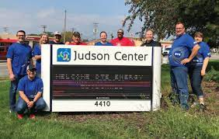
Thursday, Sept. 29: Parents in Oakland County
Youth-led and Family-led
Date: Sept. 29, 2022 (5:30 – 7pm)
Venue: Judson Center offices, Royal Oak
Sponsors: Judson Center, Autism Alliance of Michigan Michigan’s Children
Candidate Races: Newly redrawn 12th Congressional District; 7th Senate District, 8th Senate District, 6th House District, 18th House District, 56th House District

Slide 10
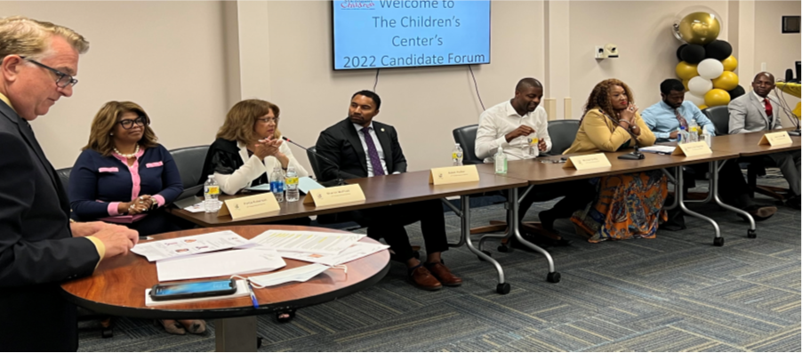
Children’s Center Candidate Forum
https://www.michiganschildren.org/2022-candidate-forums/childrens-center-candidate-forum/
Detroit
July 2022
Sponsors: The Children’s Center, The Children’s Center Youth Advisory Council, The Children’s Center Family Success Center,
Michigan’s Children
Candidate Races: Newly redrawn 13th Congressional, 8th State Senate, 8th State House

Slide 11
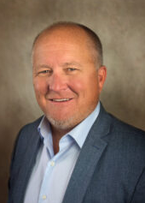
Introduction: Matt Gillard
Purpose of Youth-led, Parent-led candidate forums
Opportunity to learn where candidates stand on issues; do they represent your views?
Opportunity for participants to share their perspectives, knowledge, expertise with candidates
Benefits of Youth-led, Parent-led candidate forums
For democracy to work, all voices are important. Diversity of opinions lead to better solutions to today’s problems.
They remind elected leaders that solutions are often from the community they serve.
By educating candidates & ourselves about issues affecting kids and families in Michigan, we stand a better chance of getting them to champion those causes.
Notes:
Now let’s to the panelist for our Panel Talk.

Slide 12
Notes:
Our final thought

