Slide 1
Get Involved: Time to Speak up
for Home Visiting and MIECHV
Lunch & Learn Series
August 17, 2022

Slide 2
Today’s Agenda
Welcome
Teri Banas, Director of Programs, Michigan’s Children
Matt Gillard, President & CEO, Michigan’s Children
Home Visiting Advocacy Presentation
Amy Zaagman, Executive Director, Michigan Council for
Maternal and Child Health
Home Visiting Panel Talk
Joann Hoganson, MSN, RN, Director of Nursing, Kent
County Health Department
Katherine Logan-Dinco, Parenting Leader, Children Trust
Michigan
Becca King, Parent recipient of Healthy Family, MI HIP, Early On
Update on MIECHV Federal Funding
Kali Fox, Regional Manager, Office of U.S. Senator
Debbie Stabenow; Suzi Plasencia, Senior Policy Advisory, Linchpin Strategies
Q/A: Audience questions
Call to Action: Matt Gillard

Slide 3
Home Visiting
Opportunities to empower families
through the power of a trusted coach
August 17, 2022
Amy Zaagman
Executive Director
azaagman@mcmch.org

Slide 4
What is Home Visiting?
Home visiting is a trained professional who engages an expectant or new parent in their home to help equip them with the tools they need to build a safe, healthy, and stimulating environment for their child.
Home visitors have specific training and skills to help parents overcome challenges. They nurture, coach, educate, offer encouragement, and refer families to other services in the community as needed.
Home visiting is not new, but with interest in evidence-based strategies to impact outcomes for young children it has seen increased attention and investment at the federal and state level.

Slide 5
What is Home Visiting?
Defined in Michigan statute, Public Act 291 of 2012:
“Home visitation” means a voluntary service delivery strategy that is carried out in relevant settings, primarily in the homes of families with children ages 0 to 5 years and pregnant women.
The departments shall only support home visitation programs that include periodic home visits to improve the health, well-being, and self-sufficiency of parents and their children.
(2) Home visitation programs supported under this act shall provide face-to-face visits by nurses, social workers, and other early childhood and health professionals or trained and supervised lay workers.
(3) Home visitation programs supported under this act shall do 1 or more of the following:
(a) Work to improve maternal, infant, or child health outcomes including reducing preterm births.
(b) Promote positive parenting practices.
(c) Build healthy parent and child relationships.
(d) Enhance social-emotional development.
(e) Support cognitive development of children.
(f) Improve the health of the family.
(g) Empower families to be self-sufficient.
(h) Reduce child maltreatment and injury.
(i) Increase school readiness.
Notes:
Share definition and outcomes
Statute further limits state *and state-appropriated federal) funding to EB or promising models

Slide 6
Early Head Start
Family Spirit
Healthy Families America
Infant Mental Health
Maternal Infant Health Program
Nurse-Family Partnership
Parents as Teachers
Play and Learn Strategies
Models of Home Visiting in Michigan
Notes:
Describe models
Speak to the value of multiple models
Value of a continuum in a community
These are models – programs may have many different names
Confusing, yes…confusing!

Slide 7
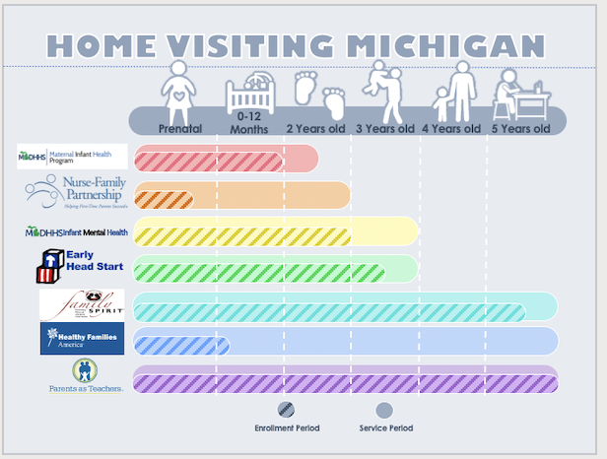

Slide 8
State Oversight and Collaboration
Michigan Department of Health and Human Services
Michigan Home Visiting Initiative
Maternal Infant Health Program
Behavioral Health
Children Trust Michigan
Michigan Department of Education
Office of the Great Start
Multiple collaborative bodies across agencies to regulate and communicate with home visiting providers as one system
State Home Visiting Advisory that includes parents and providers

Slide 9
Evidence that Home Visiting Works
MANY studies, some on home visiting as a delivery strategy and others on specific models
Two different approaches that came with federal funding
Mother and Infant Home Visiting Program Evaluation (MIHOPE study)¹
Key findings include the following:
Evidence-based home visiting has improved outcomes for parents and children across a wide range of child ages, outcome areas, and national models.
Evidence-based home visiting appears to be cost-effective in the long term.
The largest benefits from evidence-based home visiting come through reduced spending on government programs and increased individual earnings.
Entire agency that evaluates and catalogs home visiting evidence of effectiveness: homvee.acf.hhs.gov/
Across 8 domains, a rigorous evaluation of each different home visiting model to see if individual evaluations show substantial evidence of effectiveness
¹ EVIDENCE ON THE LONG-TERM EFFECTS OF HOME VISITING PROGRAMS: Laying the Groundwork for Long-Term Follow-Up in the Mother and Infant Home Visiting Program Evaluation (MIHOPE) OPRE Report 2017-73, September 2017, Authors: Charles Michalopoulos, Kristen Faucetta, Anne Warren, and Robert Mitchell. Available at: http://www.acf.hhs.gov/programs/opre
Notes:
Unusual in human services to find such a high degree of evaluation and rigor
Many studies have been done on home visiting over the years, some are pretty dated but the reuslts really have held up
You all may have heard of ther commonly cited NFP study from the late 70s that shared $1 invested in HV saves $5.70 inforegone services
The degree of rigor ramped up with the federal MIECHV funding and the evaluation required by it

Slide 10
Home Visiting Challenges
Workforce Recruitment, retention, wages, professional development
Enrollment Outreach, retention (completion of program)
Funding Consistency, rates of reimbursement
Multiple models Desire for a continuum to meet families needs and need to work together
Best fit Meaningful way to assess “best fit” and incentivize referrals
Defining need/reach Accurate statewide assessment of need
WORKFORCE: Recruitment, Retention, Wages, Professional Development
ENROLLMENT OUTREACH: Retention (Completion of Program)
FUNDING CONSISTENCY: Rates and Reimbursement
MULTIPLE MODELS: Desire for a continuum to meet families’ needs and the need to work together
BEST FIT: Meaningful way to assess ‘’best fit’’ and incentivize referrals
Defining NEED/REACH: Accurate statewide assessment of need

Slide 11
Evidence that Home Visiting Works Outcomes in Michigan
PA 291 of 2012 also requires an annual report; the state seized the opportunity to use the report as a vehicle to demonstrate outcomes
Prenatal Care
Preterm Birth
Breastfeeding
Tobacco Use
Maternal Depression
High School Completion
Postpartum Visits
Well-Child Visits
Child Maltreatment
Child Development
Find this report and previous at:
https://www.michigan.gov/homevisiting/home-visiting-reports
Notes:
Describe PA 291 report, mention 2017 report coming soon

Slide 12
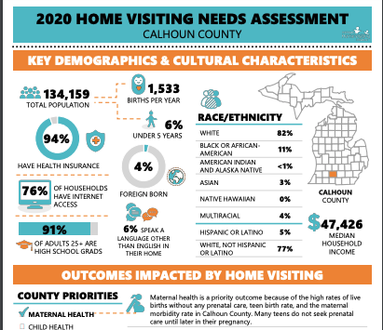
Home Visiting Advocacy Tools
Whether state or federal “ask for home visiting” it is important to know what exists and what is needed
County-based profiles have been created based of the 2020 Needs Assessment Also available at: https://www.michigan.gov/ homevisiting/home-visiting-reports
These will help tell the story when you are asked to echo an ask to state legislators or Congressional members

Slide 13
Additional Resources
With fewer than 50 days to go before the current MIECHV statute ends, the Home Visiting Coalition has developed a series of one-pagers for policymakers and the home visiting field to understand the stakes of MIECHV reauthorization. Please see below for six new resources from the coalition:
Overall MIECHV reauthorization one-pager
Home visiting ROI one-pager
MIECHV funding one-pager
The costs of not reauthorizing MIECHV one-pager
Tribal MIECHV one-pager
Virtual home visiting one-pager
Notes:
Share definition and outcomes
Statute further limits state *and state-appropriated federal) funding to EB or promising models

Slide 14
A Parent’s Story:
Early Head Start Home Visiting
“When we say home visiting, I know a lot of people are scared of someone coming in the home, and thinking they’re going to be judged. But it’s not like that at all.
“They gave me so many resources, so many ideas, just to help my baby.
“We worked together as a team.”
-- Parent Kinea Wright
https://michigancreative.wistia.com/medias/ovm2jmnhny
Notes:
2.3 minutes Early Head Start testimonial

Slide 15
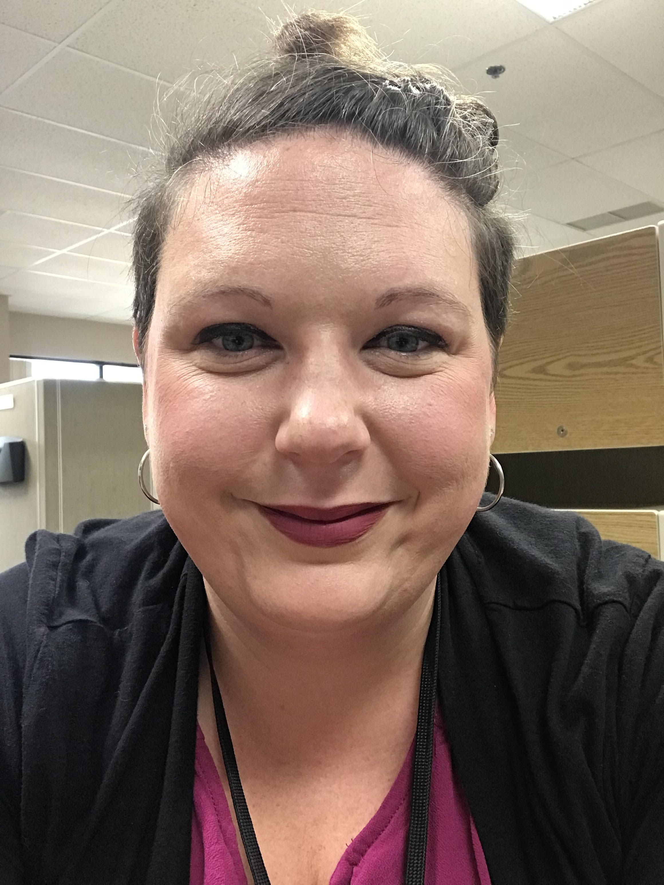
Panel Discussion Parents and provider share how Home Visiting can assist families
Katherine Logan-Dinco Joann Hoganson Becca King
How does home visiting make a difference for families? What makes it a successful approach?
What you do you think should be the top policy priorities for advocates when communicating with state and federal lawmakers?
Share your favorite home visiting moment/success story.

Slide 16
Washington Update: Where does Reauthorization of MIECHV federal funding stand?
Kali Fox,
Office of U.S. Senator Debbie Stabenow
Suzi Plasencia,
Senior Policy Advisor,
Linchpin Strategies,
Washington, D.C.
Kali_Fox@stabenow.senate.gov
517-203-1760

Slide 17
Your Questions

Slide 18
Call to Action: Supporting Voluntary Home Visiting Programs
Matt Gillard,
President/CEO, Michigan’s Children
matt@michiganschildren.org
Notes:
What now? What should Advocates do now to pump up support for HV among decision-makers? Check out our Resource page for this slide deck and other valuable information. Don’t forget to “like us” on Facebook, Instagram and Twitter. Learn more through our Friday bulletins for information about other programs and our monthly podcast, Speaking for Kids. And sign up for Think Babies Michigan!

Slide 19
Thanks for Joining Us Today Be part of the Change. Help make Michigan the best place to have and raise a Baby Join Think Babies Michigan https://tinyurl.com/yck77xz4
Notes:
What now? What should Advocates do now to pump up support for HV among decision-makers? Check out our Resource page for this slide deck and other valuable information. Don’t forget to “like us” on Facebook, Instagram and Twitter. Learn more through our Friday bulletins for information about other programs and our monthly podcast, Speaking for Kids. And sign up for Think Babies Michigan!

