Slide 1
‘Are the Kids Alright?”: Exploring Children’s Mental Health in Michigan Recording: https://tinyurl.com/rzxu6krs
Lunch and Learn, April 2022

Slide 2
Agenda
Welcome and Introduction
Teri Banas, Director of Programs and Communications, Michigan’s Children
Prospects for Improving Mental Health for Our State’s Children in the FY23 Budget Talks
Matt Gillard, President & CEO, Michigan's Children
Expert Panel Discussion
Kae Dubay, Parent Representative, Early On Michigan Interagency Coordinating Council
Mary Mackrain, Consultant, MDHHS Infant Early Childhood Mental Health Consultation Program
Danielle Rice, Workforce Development Specialist, Michigan Association for Infant Mental Health
Renee Topolski, Deputy Director, School-Community Health Alliance of Michigan
Rylee Tuggle, Board Certified Behavior Analyst, Author of “The Trusted Trio”
Audience Q & A (Please drop your Q’s in the chat.)
Wrap Up

Slide 3
Housekeeping Items:
We will be recording today’s session
Find the recording and other resources on our Lunch and Learn webpage under Resources at www.michiganschildren.org
Please put all questions and comments in the chat. Our staff will be monitoring.

Slide 4
Housekeeping Items:
Remember to ‘Think Babies Michigan’
https://www.ecic4kids.org/policy-thinkbabiesmi/

Slide 5
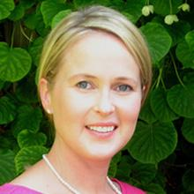
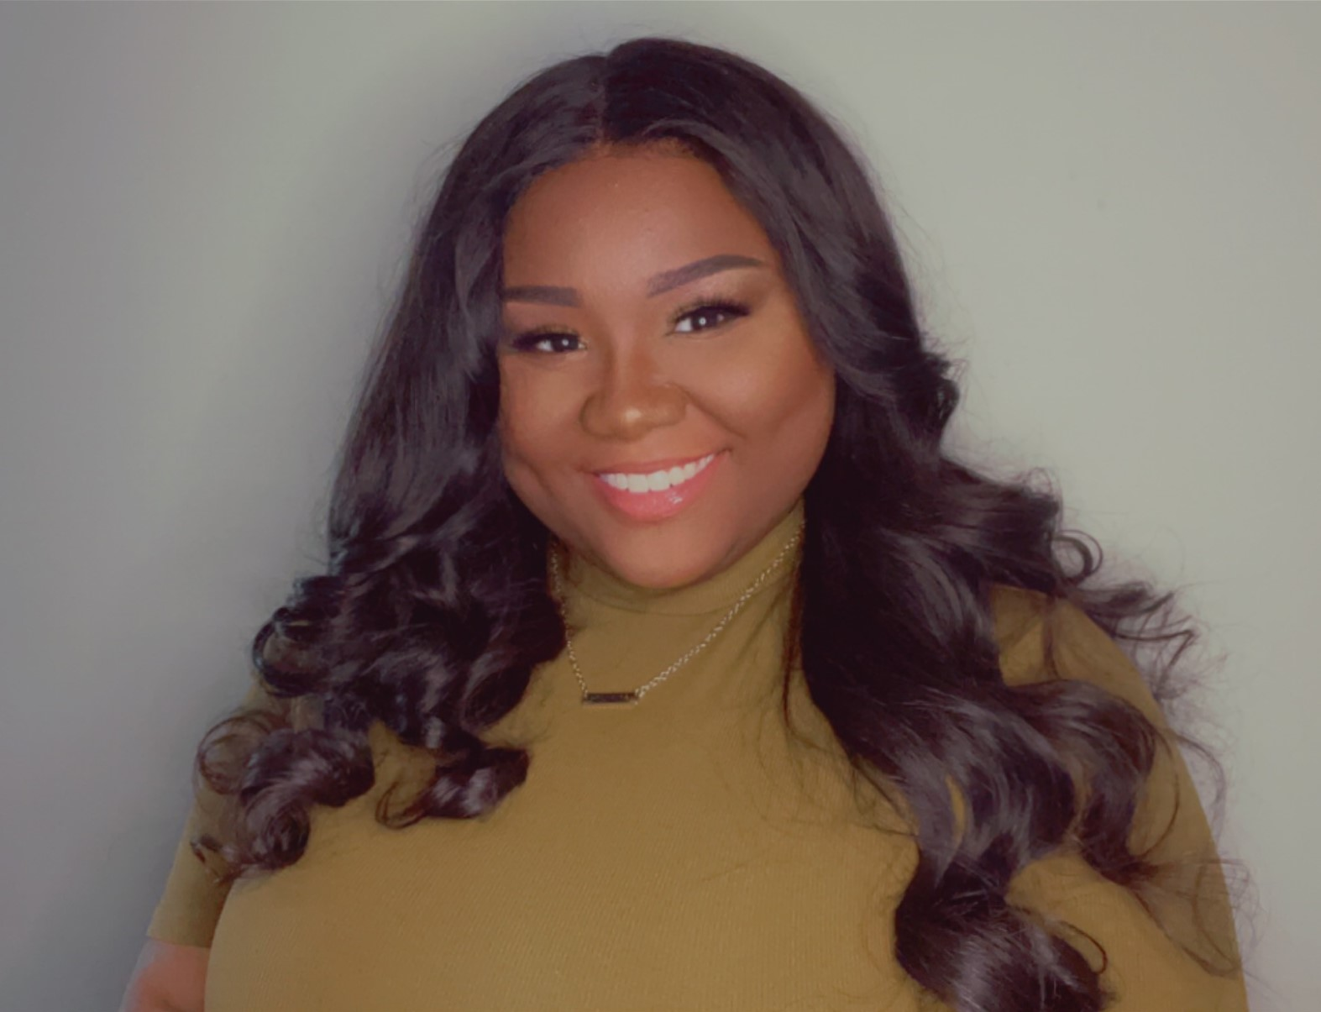
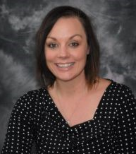
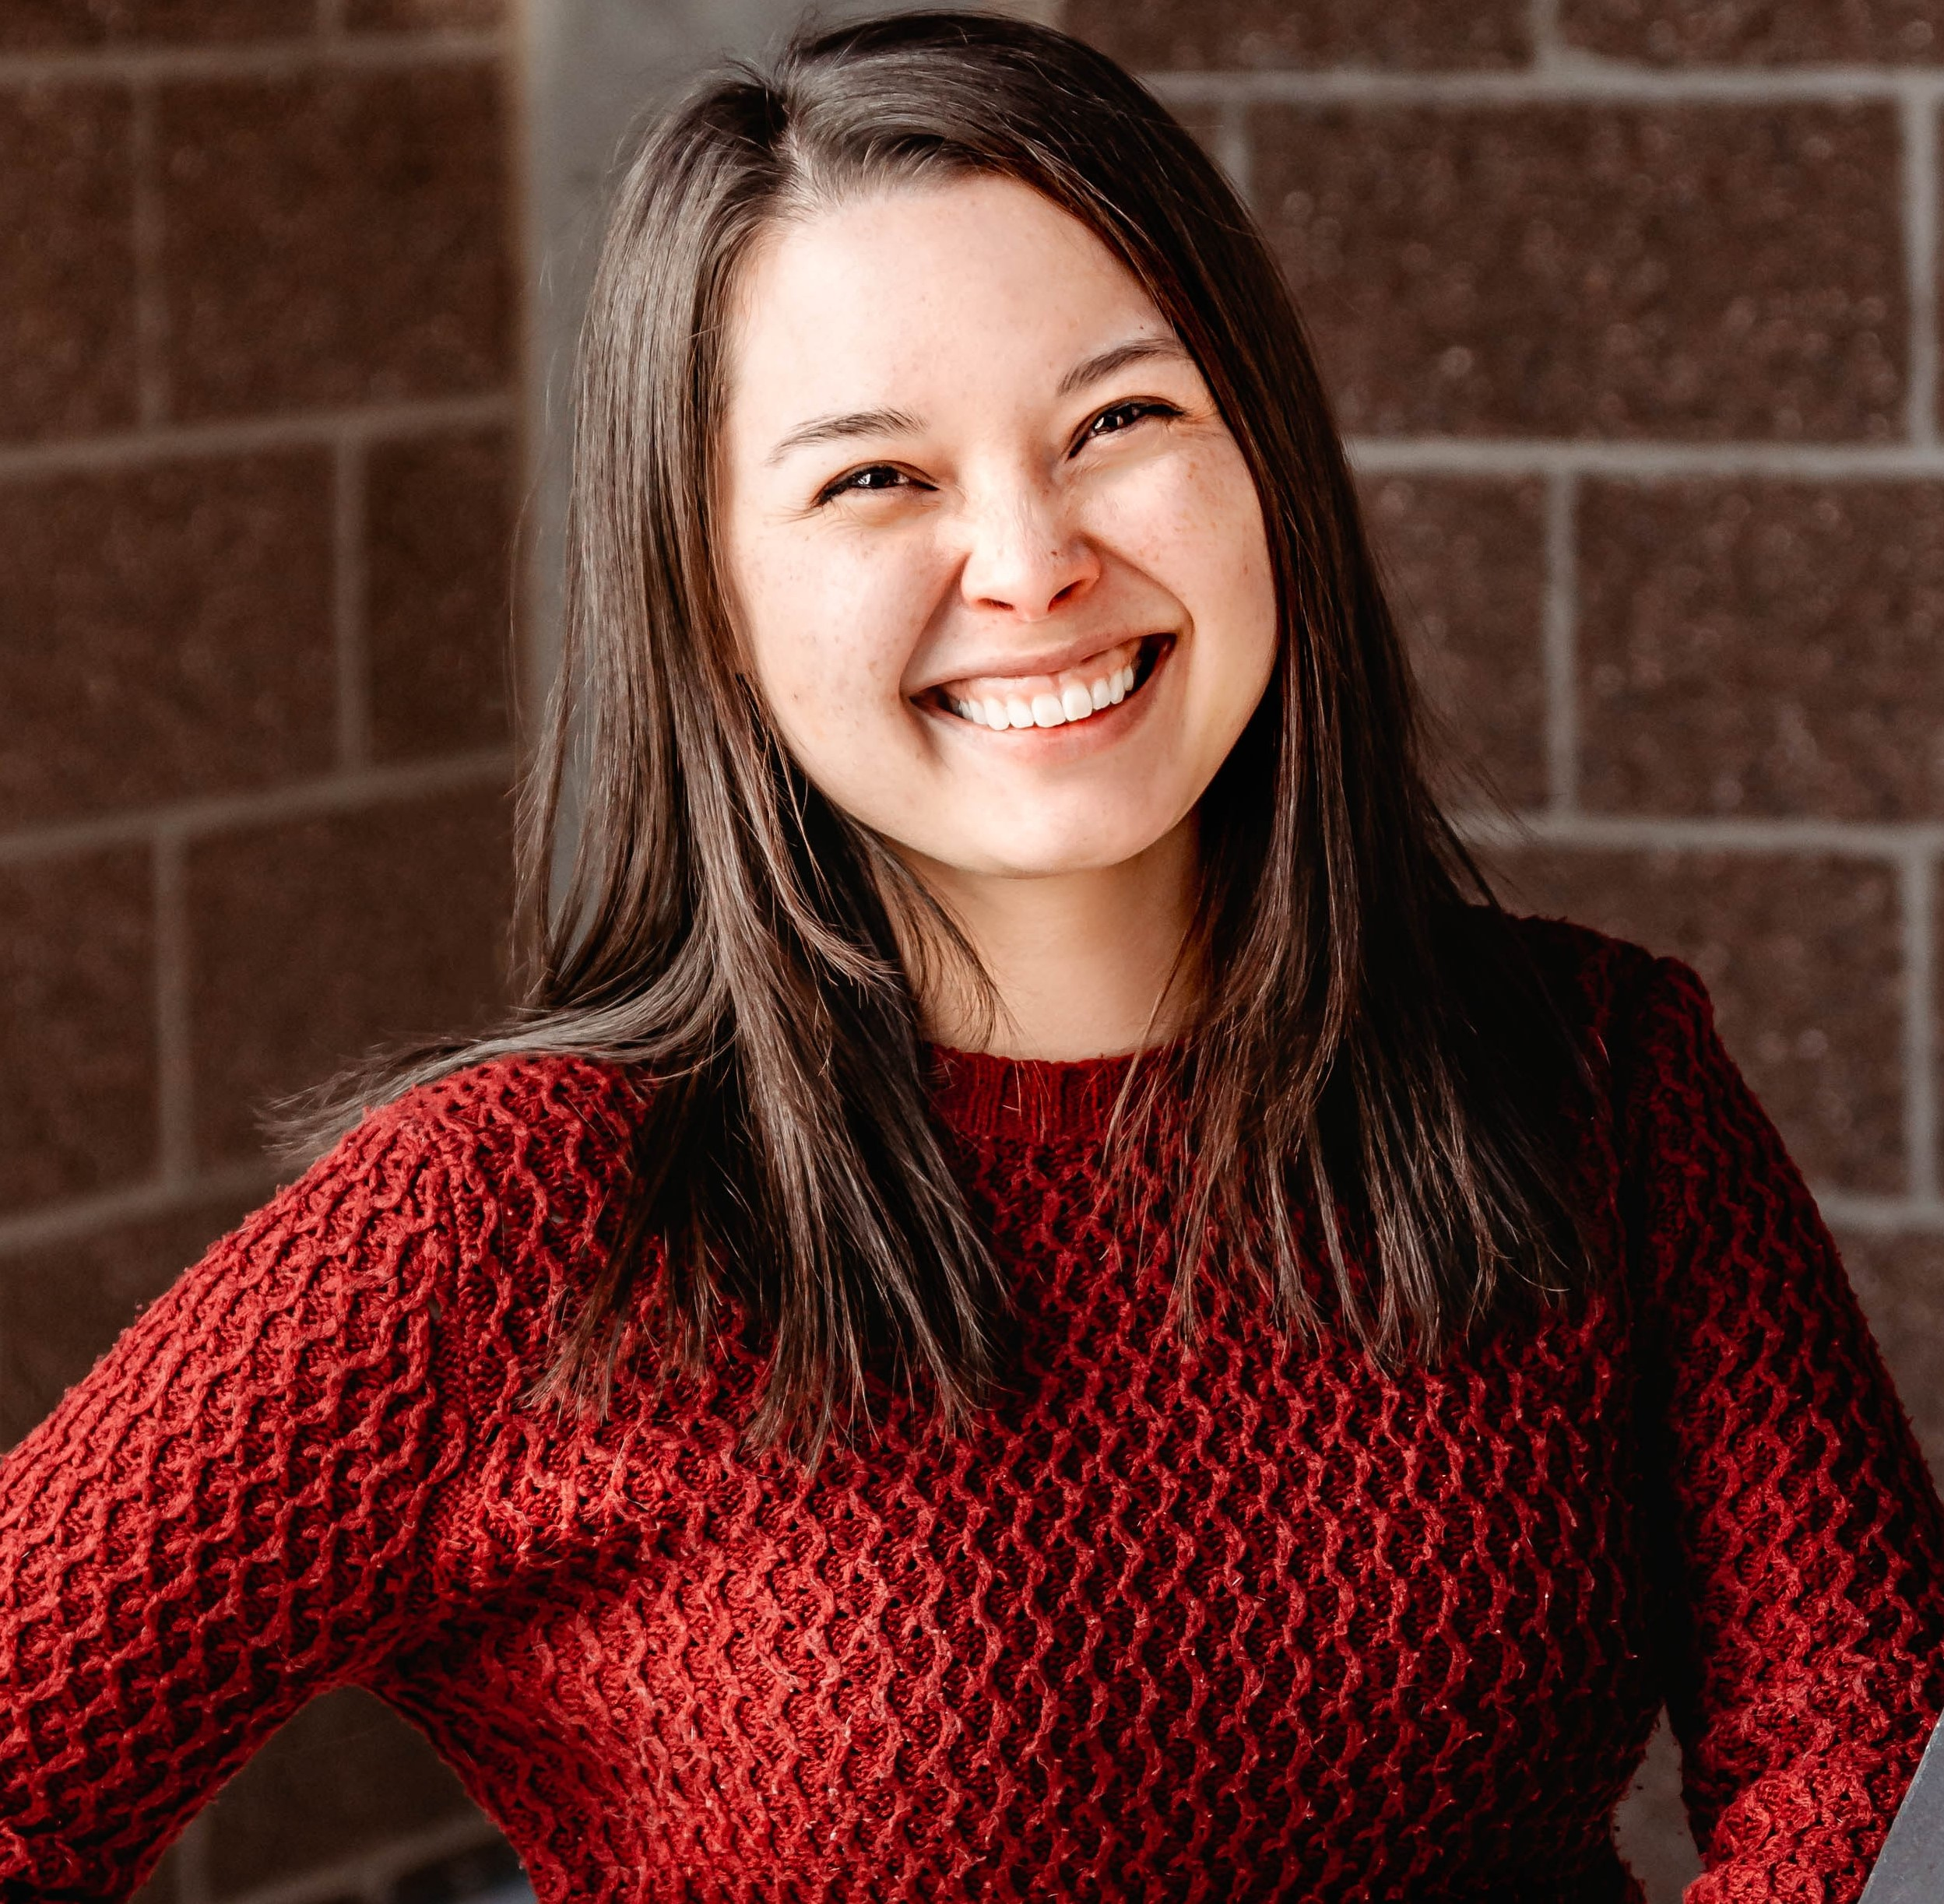
Meet the Panel
Kae Dubay,
Parent Representa-tive,
Early On Michigan Interagency Coordinating Council
Mary Mackrain,
Consultant, MDHHS Infant and Early Childhood Mental Health Consultation program
Danielle Rice,
Workforce Development Specialist, Michigan Association for Infant Mental Health
Renee Topolski,
Deputy Director, School-Community Health Alliance of Michigan
Rylee Tuggle,
Board Certified Behavior Analyst,
Author of “The Trusted Trio” on childhood trauma

Slide 6
The Prospects for Improving Mental Health for Our State’s Children in the FY23 Budget Talks What’s Out there? What’s Promising?
Matt Gillard
President & CEO, Michigan's Children

Slide 7
Panel Discussion with moderator Matt Gillard

Slide 8
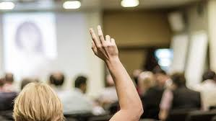
Questions &
Answers

Slide 9
Thank you for joining us!
Look for our next Lunch and Learn
on May 25th.
Like us on Facebook, Instagram, Twitter.
Questions or follow-up:
Contact Teri at teri@michiganschildren.org

