Slide 1
What Advocates Need to Know: Tax Plans and the State Budget
Lunch and Learn: March 2022

Slide 2
Housekeeping Items:
We will be recording today’s session
All our resources our available at www.michiganschildren.org
Please put all questions and comments in the chat. Our staff will be monitoring.

Slide 3
Agenda
Welcome and Introduction
Overview of Current State Tax Reform Measures:
Bobby Dorigo Jones, Michigan's Children
Prioritizing Youth, Families, and Equity in Tax Reform:
Lou Glazer, Michigan Future
Matt Gillard, Michigan's Children
Tax Cuts: Impact on Needed Services for Kids and Families after Years of Disinvestment
Jametta Lilley, Detroit Parent Network
Molly Trueblood, United Way - Kalamazoo and Battle Creek
Matt Gillard
Audience Q & A (Please drop your Q’s in the chat.)
Sharing Resources
Wrap Up

Slide 4
Navigating Tax Reform in Michigan Current Proposals and Impact on Working Families
Bobby Dorigo Jones
Vice President, Michigan's Children

Slide 5
Navigating Tax Reform in Michigan How Current Proposals Would Affect Working Families
Why We Care: Dual Crises Facing Families
Critical services simply don’t exist in many parts of the state with dire results
Worsening literacy and HS graduation rates
Poor mental health and child care access
Rising costs weigh most heavily on lower income working families & young people.
The current moment allows for balancing actions to invest our surplus into families' critical needs and to provide economic relief struggling families

Slide 6
Navigating Tax Reform in Michigan The Proposals: Personal Income Tax Cut
Legislature proposes lowering the individual income tax rate from 4.25 percent to 3.9 percent
Overall cost over $1 billion annually
Benefits of this plan are widely unequal between rich earners and low-to-modest income earners

Slide 7
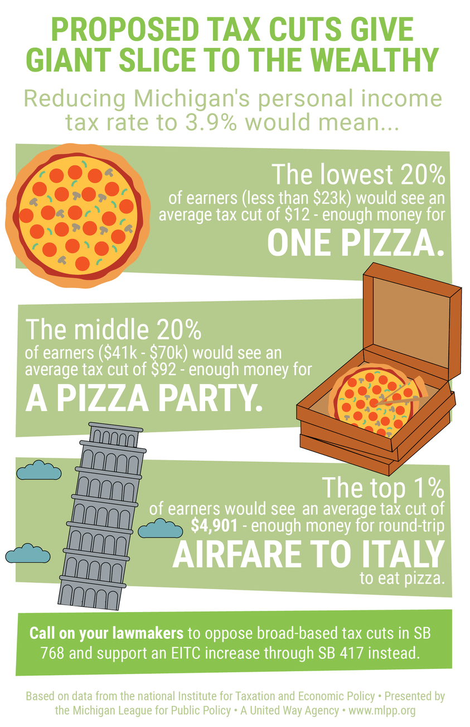

Slide 8
Navigating Tax Reform in Michigan The Proposals: Retirement Income Taxes
Michigan was one of 14 states with a tax loophole, but restricted it in 2011
Both Governor and Legislature plans restore the loophole for all retirees
Immediately for Legislature vs over 3 years for Governor
Both plans allow for the highest-income retirees to benefit
Hardly equitable, with no plans for replacing lost revenue
Notes:
$33 million for GSRP includes
Great Start Collaboratives across the state bring together stakeholders in early childhood to address the needs of children. They
connect families to early education programs and give support to early childhood providers
Include child care teachers in educator retention bonuses
- confirm the details on cc teachers and hero pay
All of these investments add up to about $75 million total

Slide 9
Navigating Tax Reform in Michigan The Proposals: Earned Income Tax Credit
Effective economic relief for working families struggling with expenses
Maximum credit is $3,526 for one child; $6,557 for three or more
Available for childless workers (ages 25-65), max amount $529
You can get it even if you would receive more than you owe in taxes (refundable)
State EITC mirrors eligibility for federal EITC
6% of total federal credit ($211 for one child)
At one time, was 20% ($705 for one child)
American Rescue Plan Act temporarily increased value and eligibility
Expired now
Notes:
$33 million for GSRP includes
Great Start Collaboratives across the state bring together stakeholders in early childhood to address the needs of children. They
connect families to early education programs and give support to early childhood providers
Include child care teachers in educator retention bonuses
- confirm the details on cc teachers and hero pay
All of these investments add up to about $75 million total

Slide 10
Navigating Tax Reform in Michigan The Proposals: Earned Income Tax Credit
Governor's Plan would grow EITC from 6% to 20% immediately
Senate Bill 417 would grow EITC to 30% by 2024
Some states have an EITC over 50% of the federal credit
Neither proposal expands the age threshold for childless EITC beyond ages 19-65
The youngest workers are often in the lowest-earning years of their career
Notes:
$33 million for GSRP includes
Great Start Collaboratives across the state bring together stakeholders in early childhood to address the needs of children. They
connect families to early education programs and give support to early childhood providers
Include child care teachers in educator retention bonuses
- confirm the details on cc teachers and hero pay
All of these investments add up to about $75 million total

Slide 11
Navigating Tax Reform in Michigan The Proposals: Non-Refundable Dependent Tax Credit
Legislature’s Plan: $500 tax credit to tax filers for each dependent under the age of 19 of the taxpayer
No income cap means most wealthy families get a hand out
Non-refundable = families who do not earn enough to owe taxes after other deductions would not receive support
Notes:
$33 million for GSRP includes
Great Start Collaboratives across the state bring together stakeholders in early childhood to address the needs of children. They
connect families to early education programs and give support to early childhood providers
Include child care teachers in educator retention bonuses
- confirm the details on cc teachers and hero pay
All of these investments add up to about $75 million total

Slide 12
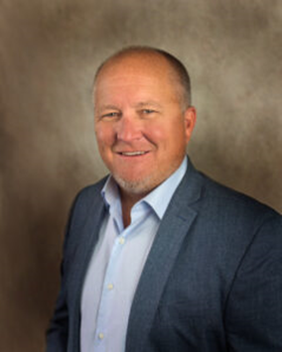
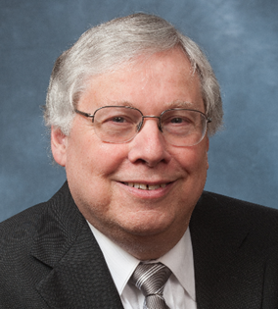
Prioritizing Youth, Families, and Equity in Tax Reform
Lou Glazer President, Michigan Future, Inc.
Matt Gillard President & CEO, Michigan's Children

Slide 13
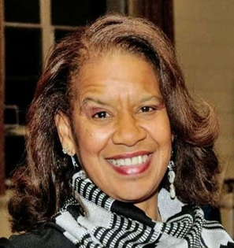
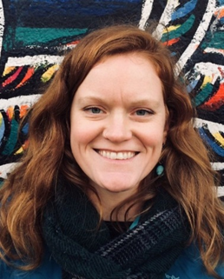
Tax Cuts: Impact on Needed Services for Kids and Families after Years of Disinvestment
Jametta Lilley CEO, Detroit Parent Network
Molly Trueblood Associate Director of Community Impact United Way - Kalamazoo and Battle Creek
Matt Gillard

Slide 14
Questions & Answers
Notes:
Who is going to be doing this?

Slide 15
Resources
See our recommendations in our brief: Navigating Tax Reform in Michigan
See our Polling on Voter Support for Investments in Kids

Slide 16
Thank you for joining us!
Look for our next Lunch and Learn on April 27th.
Like us on Facebook, Instagram, Twitter.
Questions or follow-up:
Contact Stephen Wallace, Regional Outreach and Mobilization Associate, at stephen@michiganschildren.org

