Slide 1
Michigan’s Children & Think Babies Michigan January 19, 2022 Lunch and Learn
Michigan's Early Childhood Workforce Crisis:
The Way Forward

Slide 2
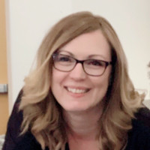
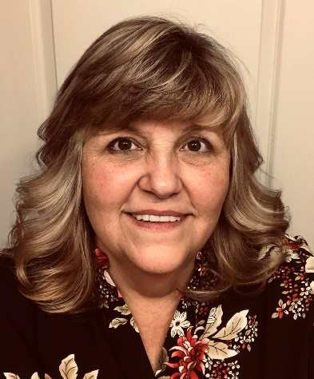
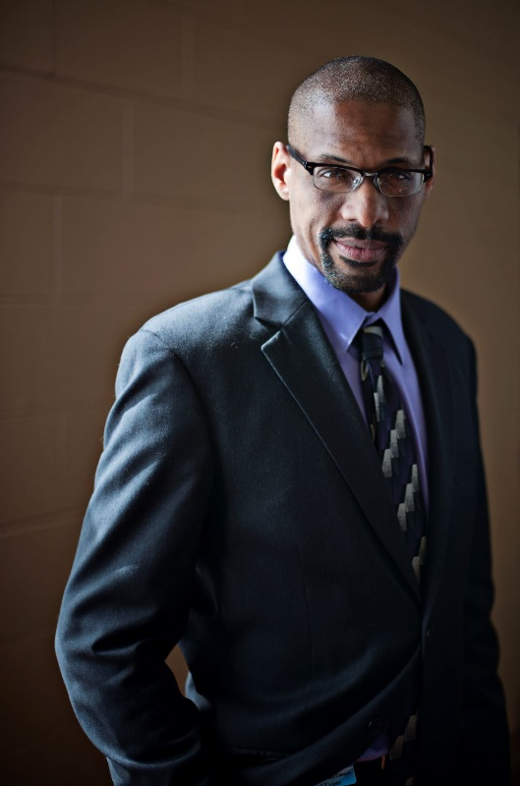
Expert Discussion: Early Childhood Panel
Dr. Ericka Taylor, Executive Director of Early Childhood, Saginaw ISD;
Co-Chair, Think Babies Michigan Cross-Sector Workforce Strategies Workgroup
Tricia Grifka,
Director of Early Childhood Services, Northeast Michigan Community Service Agency, (Head Start, Early Head Start, Great Start Readiness Program)
Susan M. Clark, Supervisor of Early Childhood, Calhoun ISD; Member, Think Babies Michigan Home Visiting Workgroup
Michael Evans, Director, Kalamazoo Literacy Council, working with Edison Neighborhood Career Pathway, ECIC Child Care Innovation Fund Grantee.
Cara Sutliffe
Parent leader/Co-Chair, Think Babies Michigan Home Visiting Workgroup

Slide 3
Agenda
Welcome (Teri Banas)
Introduction (Matt Gillard)
The crisis in the Early Childhood Workforce: How we got here
The time is now to prioritize state investments
The state budget process is our opportunity to correct compensation and retention problems across sectors
Introduction of Panelists
Panel Discussion
Audience questions
Call to Action
Closing

Slide 4
Confronting Michigan’s Early Childhood Workforce Crisis By Pat Sorenson, created by The Michigan League for Public Policy in partnership with Think Babies Michigan
https://mlpp.org/confronting-michigans-early-childhood-workforce-crisis/
Don’t Miss More Early Childhood programs: Watch “Yeas and Nays” (MLPP)
https://www.facebook.com/MichLeague/live_videos

Slide 5
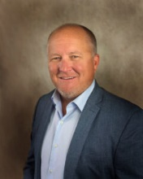
Introduction
Matt Gillard, President & CEO,
Michigan’s Children

Slide 6
Questions: Early Childhood Panel Discussion
Q.1 From your perspective, how serious is the current workforce shortage and its impact to deliver quality services in your community? How has this affected the working professionals and families in your communities?
Q.2 In an anecdote or example, tell us how difficult the struggle has been to retain your workforce.
Q. 3 Let’s talk now about how we can better support the field. What should be done to address the crisis? What have you done in your community? What are your thoughts for long-term solutions?

Slide 7
Questions from the Audience
Please share your questions in the chat box.

Slide 8
Call to Action
Contact the Governor’s Office and Legislature by email
Express your opinion for needed changes in your network, publicly including Letters to the Editor; Speak up on social media
Become involved with Think Babies Michigan

Slide 9
Thanks for joining us!
Don’t forget to download our Podcast: Speaking for Kids
You can visit our website to see all past Lunch and Learn recordings and presentations
Thank you for joining us!

