Slide 1
“The State Budget Basics: How to Gain Support for Kids and Families"
Lunch and Learn: February 2021

Slide 2
Housekeeping Items:
We will be recording today’s session
All our resources our available at www.michiganschildren.org
Please put all questions and comments in the chat. Our staff will be monitoring

Slide 3
Agenda
Welcome
Overview of the State Budget Process and Timeline (Robert Dorigo Jones)
Strategies for Engagement during the Budget Process (Matt Gillard)
Panel Discussing: Charting the Way Forward
Sharing Resources
Wrap Up

Slide 4
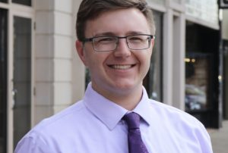
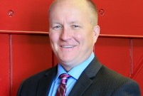
Budget Basics: Understanding the Process and Your Role Robert Dorigo Jones, Director of Public Policy, Michigan’s Children Matt Gillard, President and CEO, Michigan’s Children

Slide 5
Bobby’s slide
Feel free to add more or less

Slide 6
Bobby’s slide

Slide 7
Matt’s Slide
Feel free to add more or less

Slide 8
Matt’s Slide

Slide 9
Questions?
Notes:
Who is going to be doing this?

Slide 10
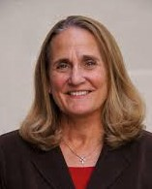
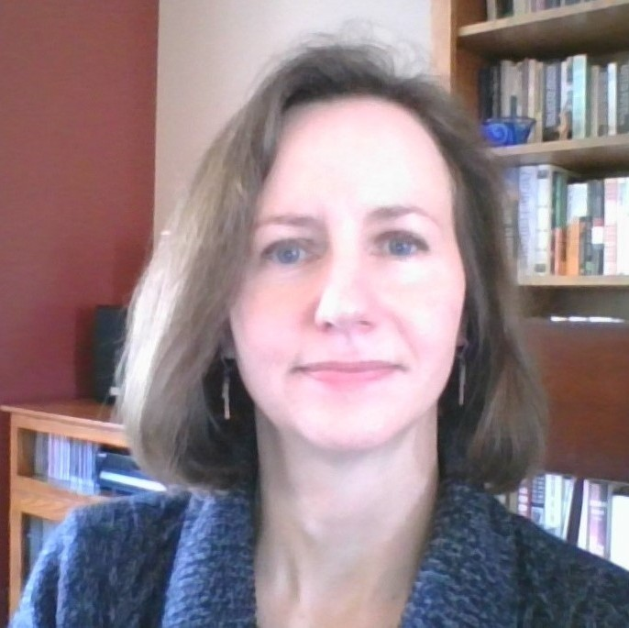
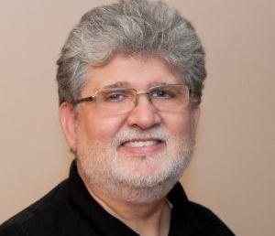
Panel Discussion: Charting the Way
Pat Sorenson, Senior Policy Analyst, Michigan League for Public Policy
Christy Callahan, President, Early On Michigan Foundation
Jim Perlaki, Treasurer, Michigan Network for Youth and Families

Slide 11
Question to the Panelists:
Thinking of your own personal experiences where you found success, or even adversity in seeking a slice of state funding, what were those key elements/conversations/turning points that either won the day or not? If you weren’t successful the first time, how did you follow up and carry the fight for another time?

Slide 12
Question to the Panelists:
What resources (demographics, data points, proposals from other states, etc) did you bring to the conversations that were helpful?

Slide 13
Question to Panelists:
Are there any final lessons learned you would like to share about the budget process and advocating for the needs of children & families?

Slide 14
Additional Resources
Budget Basics Calendar
State Budget Link
Link to Michigan’s Children Legislative Locator

Slide 15
Thank you for joining us!
Look for our next Lunch and Learn on March 17th!
Questions or Follow Up: Please contact Stephen Wallace, Community Engagement and Mobilization:
Stephen@michiganschildren.org

